Slide 1
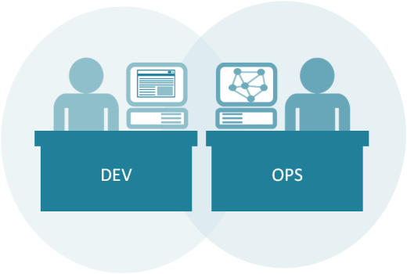
Docker
Container Implementation Boot Camp

Slide 2
Welcome!
Logistics (breaks, facilities, lunch, etc.)
Rules of Engagement
Introductions
Let’s Get Started!

Slide 3

Instructor Information
Who is your instructor?
A little about me…

Slide 4
Introductions
What is your Name and Job Role?
Your company or team?
Expectations for the class?
Something interesting about yourself?

Slide 5
What to expect from this class
Flexibility
Conversations
Literacy and awareness on many of the principles, tools, and practices surrounding Docker as part of a DevOps architecture.
An effort to focus on your own situations and challenges so you can act on what you learn.

Slide 6

Introduction to Docker
Part 1: DevOps Docker

Slide 7
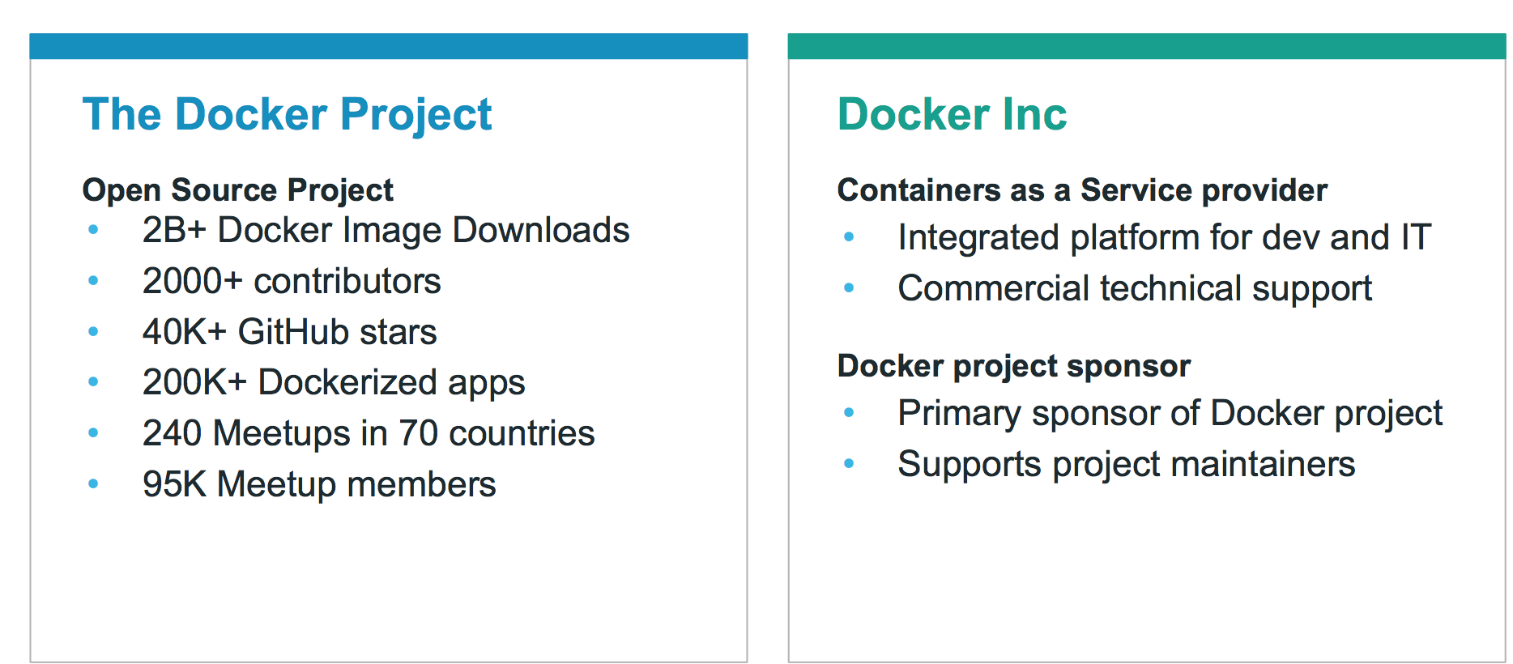
What is Docker?

Slide 8
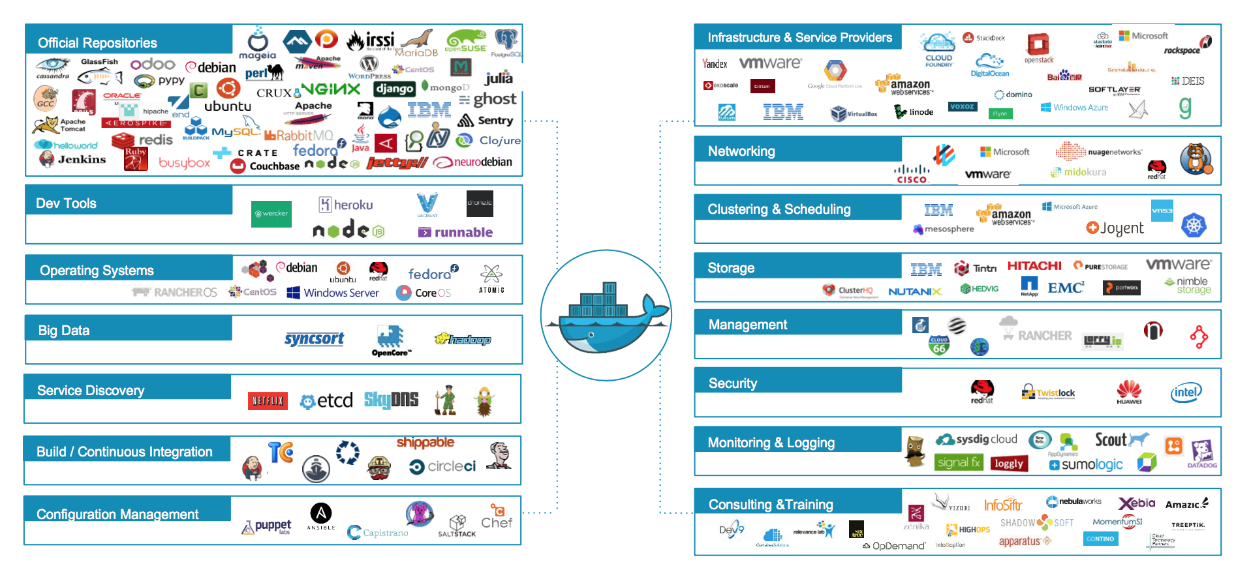
Docker ecosystem
Notes:
Official Repositories - These are repositories of popular commercial and open-source software and systems that are maintained by their “Official” providers. THese undergo special vetting, static analysis for malware, and are usually among the best-documented container images.

Slide 9

Docker Basics
Docker Image
The basis of a Docker container
Docker Container
The standard unit in which the application service resides
Docker Engine
Creates, ships and runs Docker containers deployable on physical or virtual host locally, in a datacenter or cloud service provider
Docker Registry
On-premises registry for image storing and collaboration
Notes:
A Docker image is a read-only template with instructions for creating a Docker container. For example, an image might contain an Ubuntu operating system with Apache web server and your web application installed. You can build or update images from scratch or download and use images created by others. An image may be based on, or may extend, one or more other images. A docker image is described in text file called a Dockerfile, which has a simple, well-defined syntax.
A Docker container is a runnable instance of a Docker image. You can run, start, stop, move, or delete a container using Docker API or CLI commands. When you run a container, you can provide configuration metadata such as networking information or environment variables. Each container is an isolated and secure application platform, but can be given access to resources running in a different host or container, as well as persistent storage or databases.

Slide 10
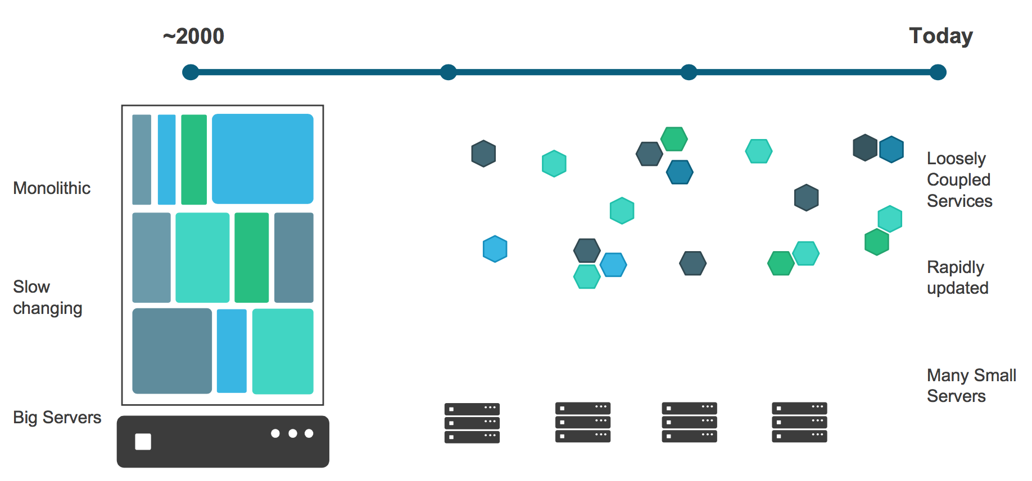
Application Evolution
Notes:
Management of software has changed radically in this time too:
We used to have big up-front specifications for “projects” that represented yearly releases, and deadlines were frequently missed.
Now we have Agile development… “projects” are mostly gone and instead we have ever-changing “products” with a much-tighter release schedule… sometimes multiple times per day.

Slide 11
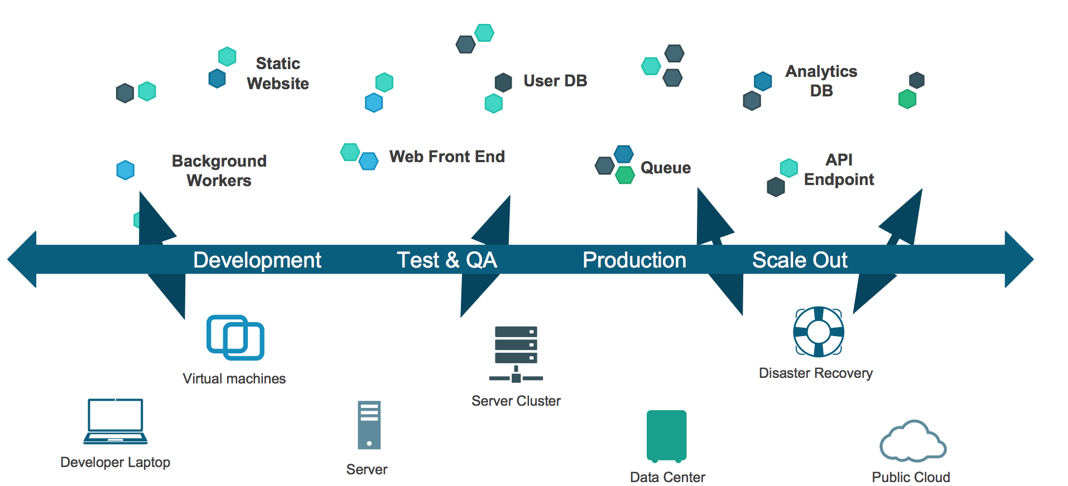
Challenge: The Dependency Matrix
“It works on MY machine.”
Notes:
A common problem for developers is the difficulty of managing all their application's dependencies in a simple and automated way.
This is usually difficult for several reasons:
Cross-platform dependencies. Modern applications often depend on a combination of system libraries and binaries, language-specific packages, framework-specific modules, internal components developed for another project, etc. These dependencies live in different "worlds" and require different tools - these tools typically don't work well with each other, requiring awkward custom integrations.
Conflicting dependencies. Different applications may depend on different versions of the same dependency. Packaging tools handle these situations with various degrees of ease - but they all handle them in different and incompatible ways, which again forces the developer to do extra work.
Custom dependencies. A developer may need to prepare a custom version of their application's dependency. Some packaging systems can handle custom versions of a dependency, others can't - and all of them handle it differently.
Docker solves the problem of dependency hell by giving the developer a simple way to express all their application's dependencies in one place, while streamlining the process of assembling them. If this makes you think of XKCD 927, don't worry. Docker doesn't replace your favorite packaging systems. It simply orchestrates their use in a simple and repeatable way. How does it do that? With layers.
Docker defines a build as running a sequence of Unix commands, one after the other, in the same container. Build commands modify the contents of the container (usually by installing new files on the filesystem), the next command modifies it some more, etc. Since each build command inherits the result of the previous commands, the order in which the commands are executed expresses dependencies.
Here's a typical Docker build process:
FROM ubuntu:12.04 RUN apt-get update && apt-get install -y python python-pip curl RUN curl -sSL https://github.com/shykes/helloflask/archive/master.tar.gz | tar -xzv RUN cd helloflask-master && pip install -r requirements.txt
Note that Docker doesn't care how dependencies are built - as long as they can be built by running a Unix command in a container.
Reference: https://github.com/docker/docker

Slide 12
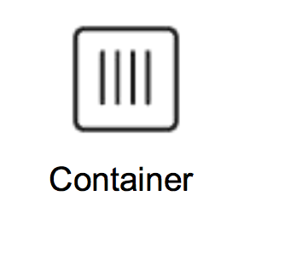
Containers as a Solution
Packages up software binaries and dependencies
Isolates software from each other
Container is a standard format
Easily portable across environment
Allows ecosystem to develop around its standard

Slide 13
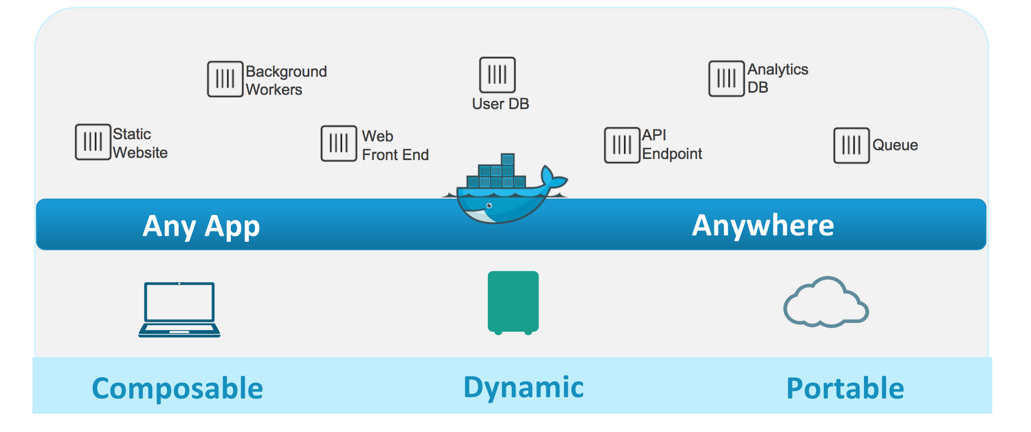
Containers as a Solution

Slide 14
Developer Benefits
Build once...(finally) run anywhere
A clean, safe, hygienic and portable runtime environment for your app.
No worries about missing dependencies, packages and other pain points during subsequent deployments.
Run each app in its own isolated container, so you can run various versions of libraries and other dependencies for each app without worrying
Automate testing, integration, packaging...anything you can script
Reduce/eliminate concerns about compatibility on different platforms, either your own or your customers.
Cheap, zero-penalty containers to deploy services? A VM without the overhead of a VM? Instant replay and reset of image snapshots? That’s the power of Docker
Notes:
One big driver for the initial adoption of Docker has been startups in an effort to drive down their Cloud Bill. There is lots of anecdotal evidence of startups cutting their cloud bill in half by using Docker to increase utilization. Instead of having a single VM for a database for example, putting a database, mid tier and front end container all in the same VM thus using less resources overall.

Slide 15
Operational Benefits
Configure once...run anything
Make the entire lifecycle more efficient, consistent, and repeatable
Increase the quality of code produced by developers.
Eliminate inconsistencies between development, test, production, and customer environments
Support segregation of duties
Significantly improves the speed and reliability of continuous deployment and continuous integration systems
Because the containers are so lightweight, address significant performance, costs, deployment, and portability issues normally associated with VM

Slide 16
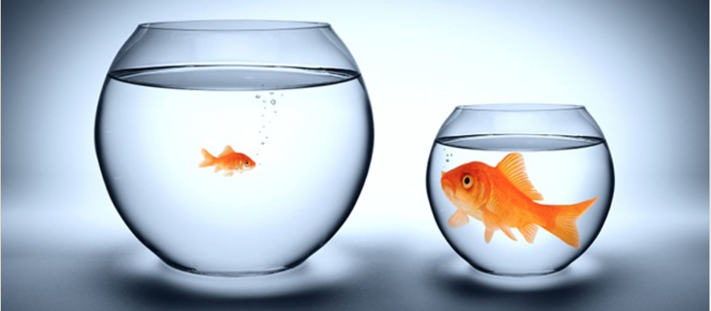
VMs vs. Containers
Notes:
A badly kept secret on cloud is the over-provisioning of VMs for workloads. The average CPU utilization on the average data center VM is between 6-12% and this is part of the reason for a very healthy ecosystem of cloud consultants.
Containers are more lightweight and are typically filled with higher density workloads.
https://gigaom.com/2013/11/30/the-sorry-state-of-server-utilization-and-the-impending-post-hypervisor-era/

Slide 17
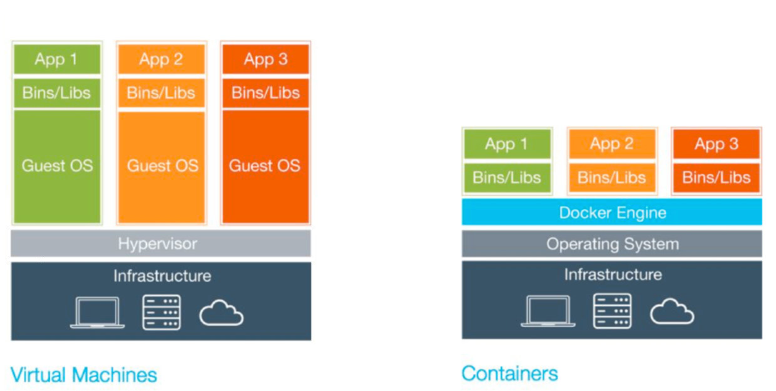
VMs vs. Containers

Slide 18
VMs vs. Containers
Virtual Machines (VMs) | Containers
Represents hardware-level virtualization | Represents operating system virtualization
Heavyweight | Lightweight
Slow provisioning | Real-time provisioning and scalability
Limited performance | Native performance
Fully isolated and therefore more secure (maybe) | Process-level isolation and therefore less secure (maybe)
Notes:
Size: VMs are very large which makes them impractical to store and transfer.
Performance: running VMs consumes significant CPU and memory, which makes them impractical in many scenarios, for example local development of multi-tier applications, and large-scale deployment of cpu and memory-intensive applications on large numbers of machines.
Portability: competing VM environments don't play well with each other. Although conversion tools do exist, they are limited and add even more overhead.
Hardware-centric: VMs were designed with machine operators in mind, not software developers. As a result, they offer very limited tooling for what developers need most: building, testing and running their software. For example, VMs offer no facilities for application versioning, monitoring, configuration, logging or service discovery.
Reference: https://github.com/docker/docker

Slide 19
VMs vs. Containers
Simulates a physical machine
Provides a local file system
Can be accessed over a network
Full and independent guest operating system
Virtualized device drivers
Strong resource and memory management
Huge memory foot-print
Needs a hypervisor
Notes:
The first three layers (black items) are those that are essentially shared by both VM and Container approaches.
The balance of the list describes elements (mostly cons) specific to true Virtual Machines.

Slide 20
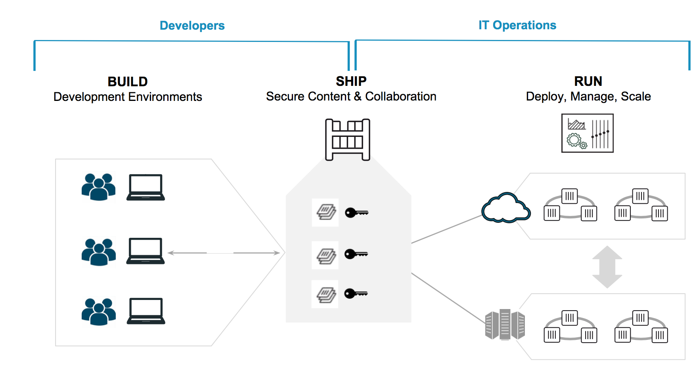
Dev/Ops Container Workflow

Slide 21
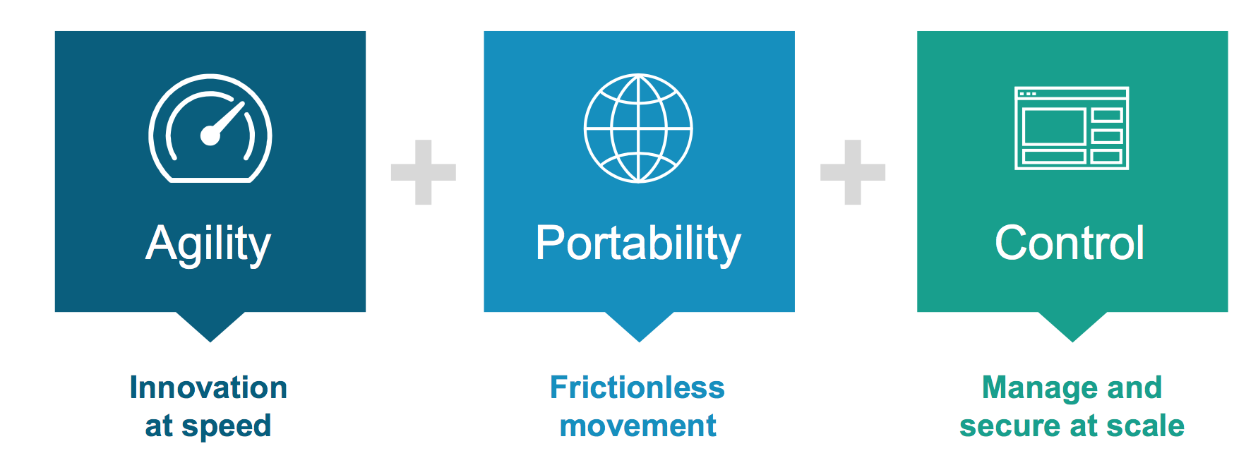
Container Benefits

Slide 22
Docker CE vs. Docker EE
 | COMMUNITY EDITION | ENTERPRISE EDITION BASIC | ENTERPRISE EDITION STANDARD | ENTERPRISE EDITION ADVANCED
Container engine and built in orchestration, networking, security | ✓ | ✓ | ✓ | ✓
Docker Certified - Infrastructure, Plugins and ISV (independent software vendors) Containers |  | ✓ | ✓ | ✓
Image Management (private registry, caching) | Cloud hosted repos |  | ✓ | ✓
Docker Datacenter - Integrated container app management |  |  | ✓ | ✓
Docker Datacenter - Multi-tenancy with RBAC, LDAP/AD support |  |  | ✓ | ✓
Integrated secrets mgmt, image signing policy |  |  | ✓ | ✓
Image security scanning | Preview |  |  | ✓
Support | Community | Biz Day or 24x7 | Biz Day or 24x7 | Biz Day or 24x7
Pricing | Free | $750/node/year | $1,500/node/year | $2,000/node/year
Notes:
We will be using Community Edition exclusively for our in-class work, but it’s valuable to know the differences.

Slide 23
Installing Docker
Docker container engine is built from and on top of the Linux kernel, so it needs Linux to run natively*
Docker is increasingly being packaged with newer Linux distributions
Docker is also available on MacOS and Windows through the use of lightweight Linux VMs - HyperV-based on Windows, HyperKit-based on MacOS
* Native Windows containers can also be used with Docker for Windows if you have very specific versions of Windows.

Slide 24

Prerequisite: Connect to Classroom VM
CLASSROOM WORK
$ ssh student@FQDN
student password = DockerStudentPW0
FQDN = The fully qualified domain name of the machine assigned to you by your instructor. This will commonly be in the form docker#.domain.com (where # is your student number as assigned to you by your instructor).
Notes:
SSH using windows:
Use putty to generate ppk file from “docker_key_pair.pem” and then ubuntu@<public_ip_v4> and give ppk file path in “ssh -> auth”
SSH using linux:
chmod 400 docker_key_pair.pem
ssh -i "docker_key_pair.pem" ubuntu@<public_ip_v4>
Ideally students are able to ssh directly into the classroom VMs.

Slide 25
Prerequisite: Add & Update Repos
CLASSROOM WORK
Done already in AWS instances
$ sudo apt-get update
$ sudo apt-get -y install apt-transport-https ca-certificates curl
$ curl -fsSL https://download.docker.com/linux/ubuntu/gpg | sudo apt-key add -
$ sudo add-apt-repository \
"deb [arch=amd64] https://download.docker.com/linux/ubuntu \
$(lsb_release -cs) \
stable"
$ sudo apt-get update
Also at
https://docs.docker.com/engine/installation/
Notes:
First run: sudo apt-get update
Docker docs URL:- https://docs.docker.com/engine/installation/linux/docker-ce/ubuntu/#install-using-the-repository
Set up the repository
Install packages (if necessary) to allow apt to use a repository over HTTPS:
$ sudo apt-get -y install apt-transport-https ca-certificates curl
Add Docker’s official GPG key:
$ curl -fsSL https://download.docker.com/linux/ubuntu/gpg | sudo apt-key add -
Use the following command to set up the stable repository.
Note: The lsb_release -cs sub-command below returns the name of your Ubuntu distribution, such as xenial.
$ sudo add-apt-repository \
"deb [arch=amd64] https://download.docker.com/linux/ubuntu \
$(lsb_release -cs) \
stable"

Slide 26
Install Docker-CE
CLASSROOM WORK
Done already in AWS instances
$ sudo apt-get -y install docker-ce
$ sudo docker run hello-world
Also at
https://docs.docker.com/engine/installation/linux/docker-ce/ubuntu/#install-using-the-repository
Notes:
Install docker Community Edition
$ sudo apt-get -y install docker-ce
Verify docker is installed correctly
$ sudo docker run hello-world
This command downloads a test image and runs it in a container. When the container runs, it prints an informational message. Then, it exits.

Slide 27
Installing Docker Script
It’s good to install Docker the “hard” way at least once so you understand what is involved.
There is a Docker-maintained community script that will install the latest release on your Linux machine (most popular flavors) available at https://get.docker.com/
Run ‘curl -sSL https://get.docker.com/ | sh’ in your terminal
The script will also install a Union File System driver and verify Docker engine functionality
Notes:
sudo service docker stop
sudo service docker status
sudo apt-get remove docker
sudo apt-get remove docker-engine
sudo apt-get remove docker-ce
Union File System
Docker is a fast moving project, and often critical bugs are fixed in newer versions. When working with Docker it is best to work with latest when possible.
Have students visit https://get.docker.com to see that it is a full script… we are passing the script to sh for execution.

Slide 28
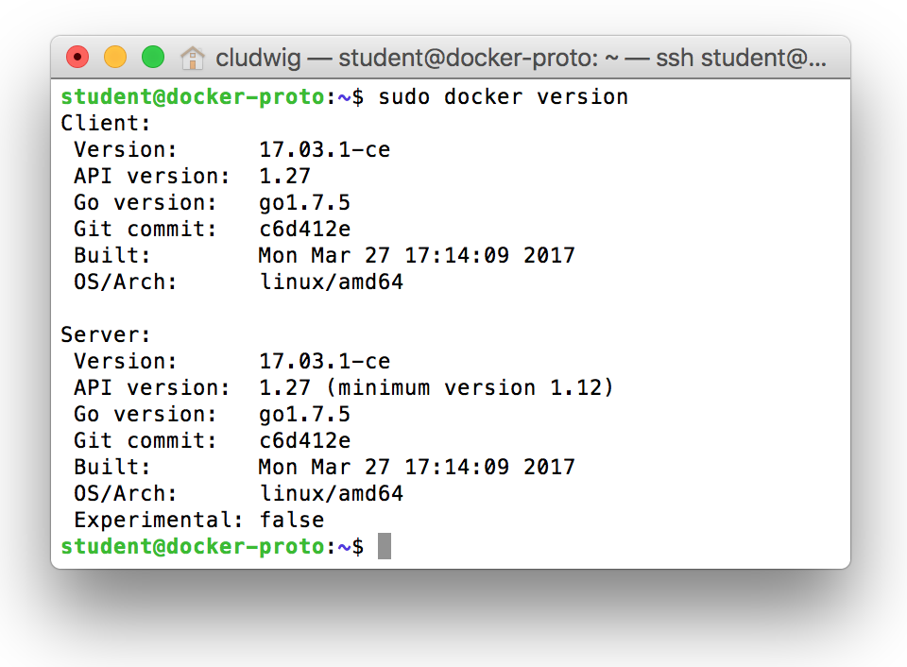
Docker Basics
$ sudo docker version
Notes:
Starting with v17.03.0-ce, Docker is on a monthly release cycle and uses a new YY.MM versioning scheme to reflect this. Two channels are available: monthly and quarterly.
Any given monthly release will only receive security and bugfixes until the next monthly release is available. Quarterly releases receive security and bugfixes for 4 months after
initial release. This release includes bugfixes for 1.13.1 but there are no major feature additions and the API version stays the same.
Docker version is useful for troubleshooting as well. The Server version will not be available if the Docker engine service is not running, which is a great place to start if you find docker commands are hanging or being unresponsive.
$ sudo service docker start # start the service

Slide 29
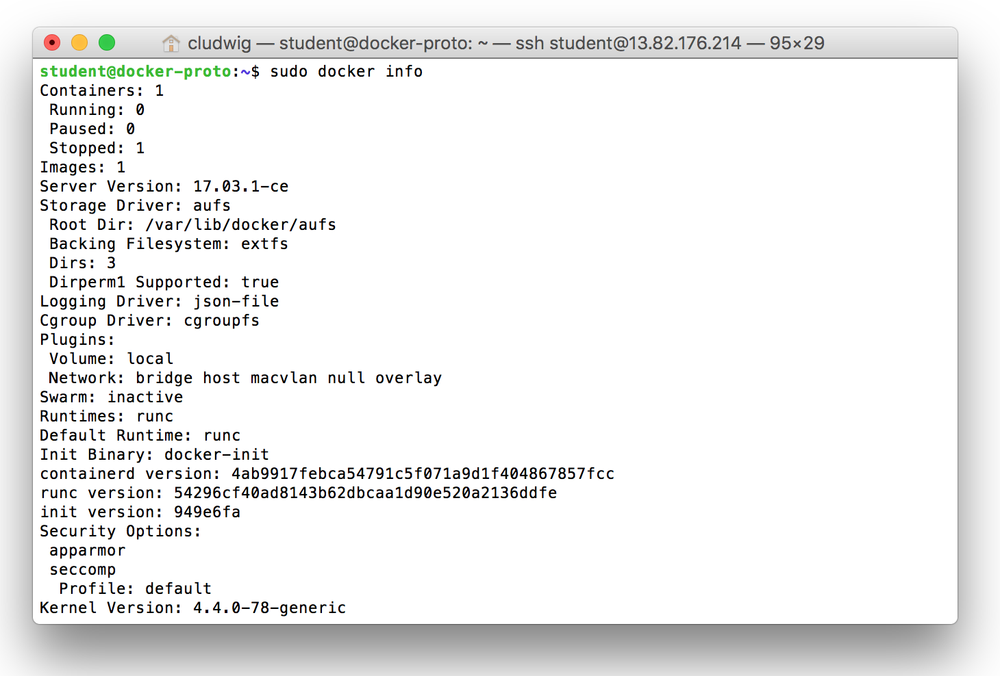
Docker Basics
$ sudo docker info
Notes:
Provides a number of pieces of engine and system information.

Slide 30
Docker Basics
Standard command format:
docker [NOUN] verb
$ sudo docker --help #displays help and management subcommands (nouns)
$ sudo docker NOUN --help
There are reasonable defaults and short forms of option flags for many things. i.e.:
“docker pull” assumes “image”
“docker stop” assumes “container”
can use “img” instead of “image”
can use “con” instead of “container”, etc.

Slide 31
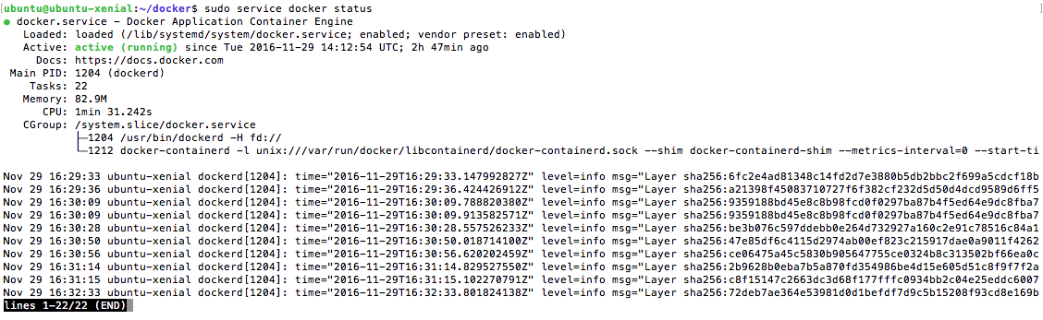
Docker Basics
Determine the status of the Docker service
$ sudo service docker status
Notes:
Also a great starting point if Docker is unresponsive.
$ sudo service docker start # start the service

Slide 32
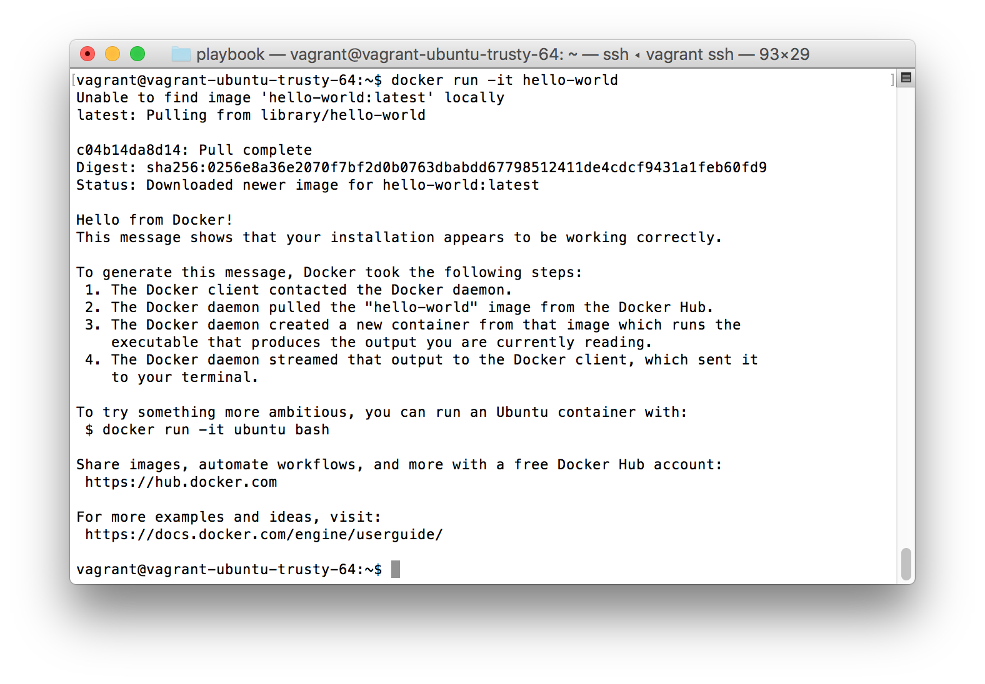
Docker Hello World(s)
Notes:
docker run -it hello-world
This will likely NOT work at first… must use sudo. We will fix that soon.

Slide 33
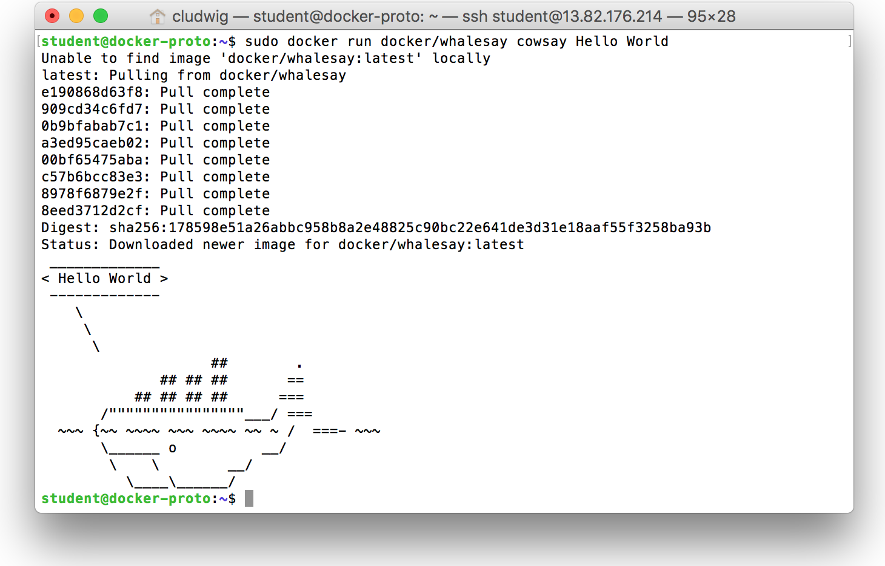
Docker Hello World(s)
$ sudo docker run docker/whalesay cowsay Hello World
Notes:
$ sudo docker run docker/whalesay cowsay Hello World

Slide 34
Docker Hello World(s)
Tells docker to run a cmd in container
Cmd to run inside
container
docker run docker/whalesay cowsay Hello World
Base image for
container
Argument to
Cowsay cmd

Slide 35

What is ‘Docker Engine’?
Notes:
The CLI uses the Docker REST API to control or interact with the Docker daemon through scripting or direct CLI commands. Many other Docker applications use the underlying API and CLI.
The daemon creates and manages Docker objects, such as images, containers, networks, and data volumes.

Slide 36
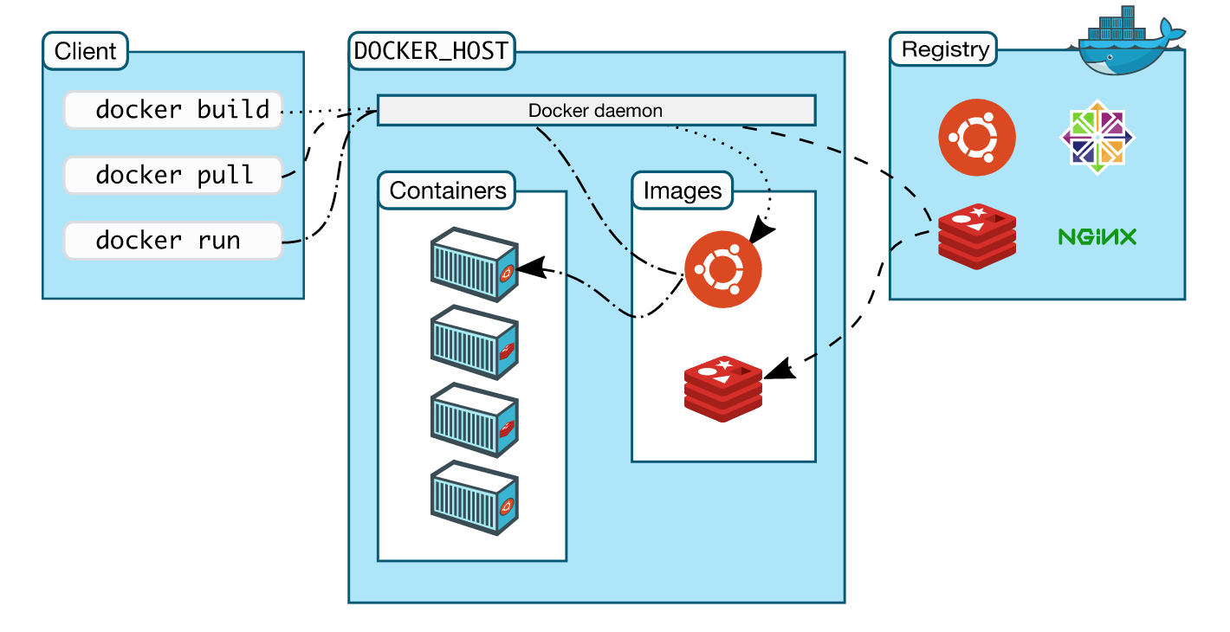
How is Docker Architected?
Notes:
Docker uses a client-server architecture. The Docker client talks to the Docker daemon, which does the heavy lifting of building, running, and distributing your Docker containers. The Docker client and daemon can run on the same system, or you can connect a Docker client to a remote Docker daemon. The Docker client and daemon communicate via sockets or through a REST API.
Note: The Docker daemon runs with root privileges which introduces an attack opportunity. More behind this: https://docs.docker.com/engine/security/security/

Slide 37
No ‘sudo’ Configuration
Done already in AWS instances
Run docker without sudo
https://docs.docker.com/engine/installation/linux/linux-postinstall/
Create Docker group:
$ sudo groupadd docker
Add your user to docker group:
$ sudo usermod -aG docker $USER
Log out and log back in:
$ exit # then log back in
Notes:
Newer installs do this for you, but of course you still have to logout and back in.

Slide 38
Docker Webapp & Hello World
CLASSROOM WORK
20 minutes
Exercise 2.1 in Docker Labs
https://github.com/docker/labs/blob/master/beginner/chapters/webapps.md
Do only exercise 2.1
Notes:
https://github.com/docker/labs/blob/master/beginner/chapters/webapps.md

Slide 39
So far !!
Basic difference between VMs and Containers
Installing Docker
Images:- Hello World, whalesay, static-website in action

Slide 40
Where Containers are used? - For automated testing & CICD
Commit Stage
- Compile
- Unit Test
- Analysis
- Build Installers
Automated Acceptance Test
Automated Capacity Testing
Manual Testing
- Showcases
- Exploratory
testing
Release

Slide 41
Where Containers are used?
DevOps (Mostly in all types of Automation)
Automated testing (Unit, acceptance and stress testing)
CICD (if not tested on production-like environment, CICD will be risky)
Microservices
Less risky deployment architectures
Chef kitchen test
Not only used for testing but is used in production (along with container orchestration) in B2C and B2B organizations

Slide 42
Advantage of using Containers
Developers testing their code in Prod environments
Lesser hand-offs and drastically lesser waiting time (to get new environment setup)
Reduce technical debt
Overall system resilience - Service failure does not kill the application & may be invisible to users
Scalability
Seamless replication
High Availability
Less risky patterns for rolling updates available
Prevent server sprawl and Jenga infrastructure

Slide 43
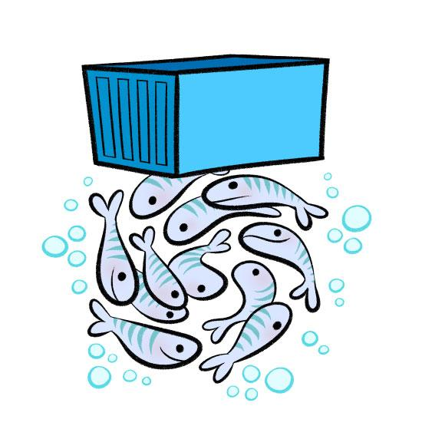
Docker Images
Part 2: DevOps Docker

Slide 44
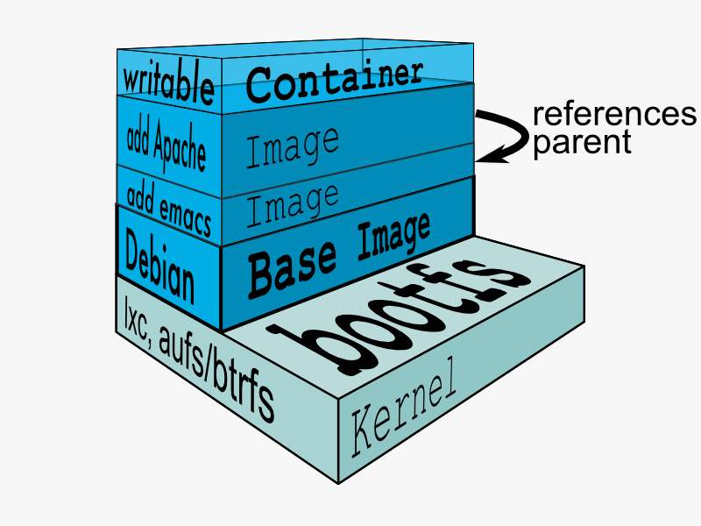
Docker Union File System
AuFS (AnotherUnionFS) is a multi-layered filesystem that implements union mount
allows several filesystems or directories to be simultaneously mounted and visible through a single mount point
appears to be one filesystem to the end user
Notes:
Union file systems, or UnionFS, are file systems that operate by creating layers, making them very lightweight and fast. Docker Engine uses UnionFS to provide the building blocks for containers. Docker Engine can use multiple UnionFS variants, including AUFS (the default for Ubuntu), btrfs, vfs, and DeviceMapper (the default for Red Hat and Centos.
How AuFS Works
1.Mount a base image as read-only
2.Add read-write file system over read-only file system
3.Change some files and directories to top as read- write file system
4.It is committed
5.Save incremental files and directories in new image
6.Mount the image as read-only and add read-write file system on top

Slide 45
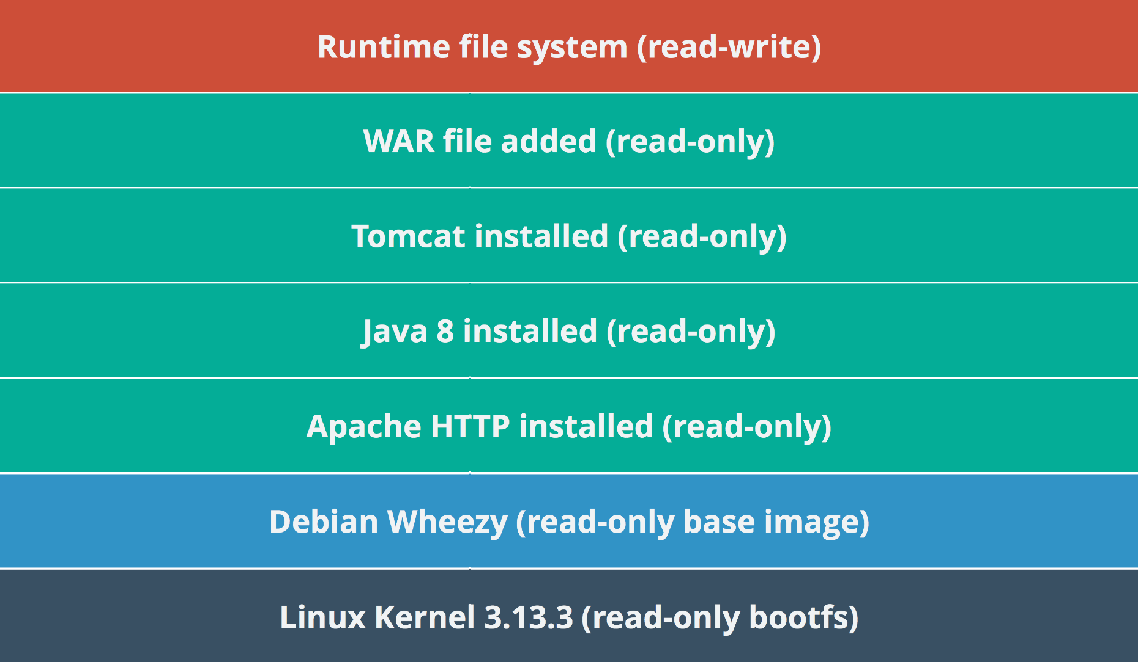
Example Docker Layers
Docker Layer – Each Docker image is composed of a series of layers. Docker uses Union File Systems to combine these into a single image. The combination of these layers gives the illusion of a traditional file system. Only the top layer is writeable.

Slide 46
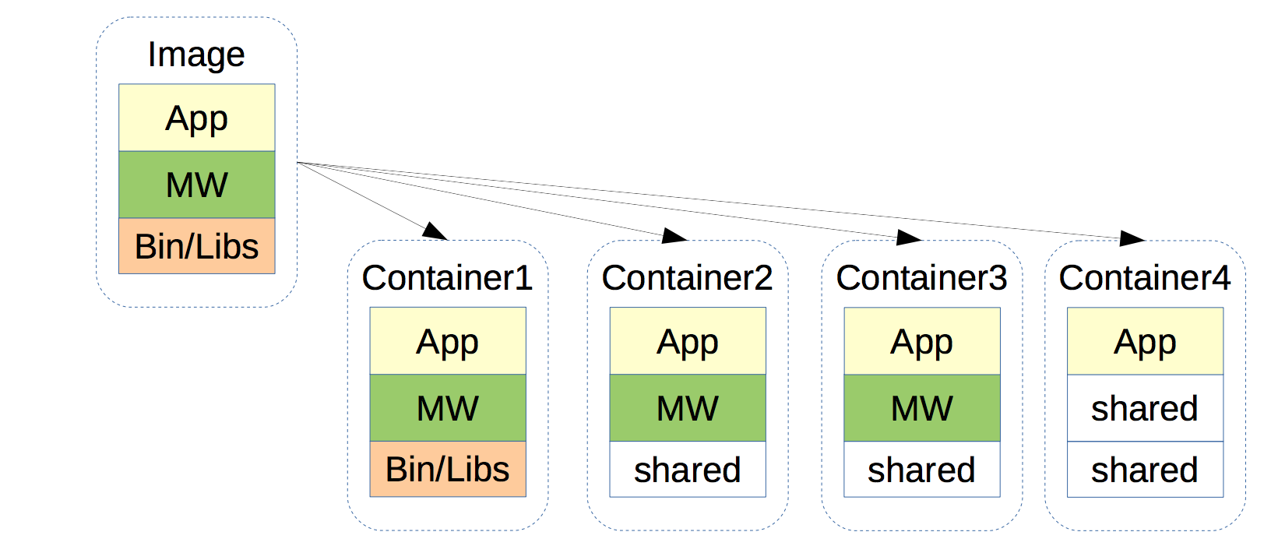
Benefits of Union File Systems
Files are shared across containers
Storage and memory spaces are saved
Faster deployment of containers

Slide 47
Docker Hub
Docker’s first-party cloud-based registry
Hosts a broad repository of Docker images
Contains nearly any popular open source technology including MariaDB, Jenkins, Cloudera, etc
Contains ‘Official images’ from vendors such as Canonical, Oracle, Red Hat, etc
Provides one free private Docker repo, more for a paid subscription

Slide 48
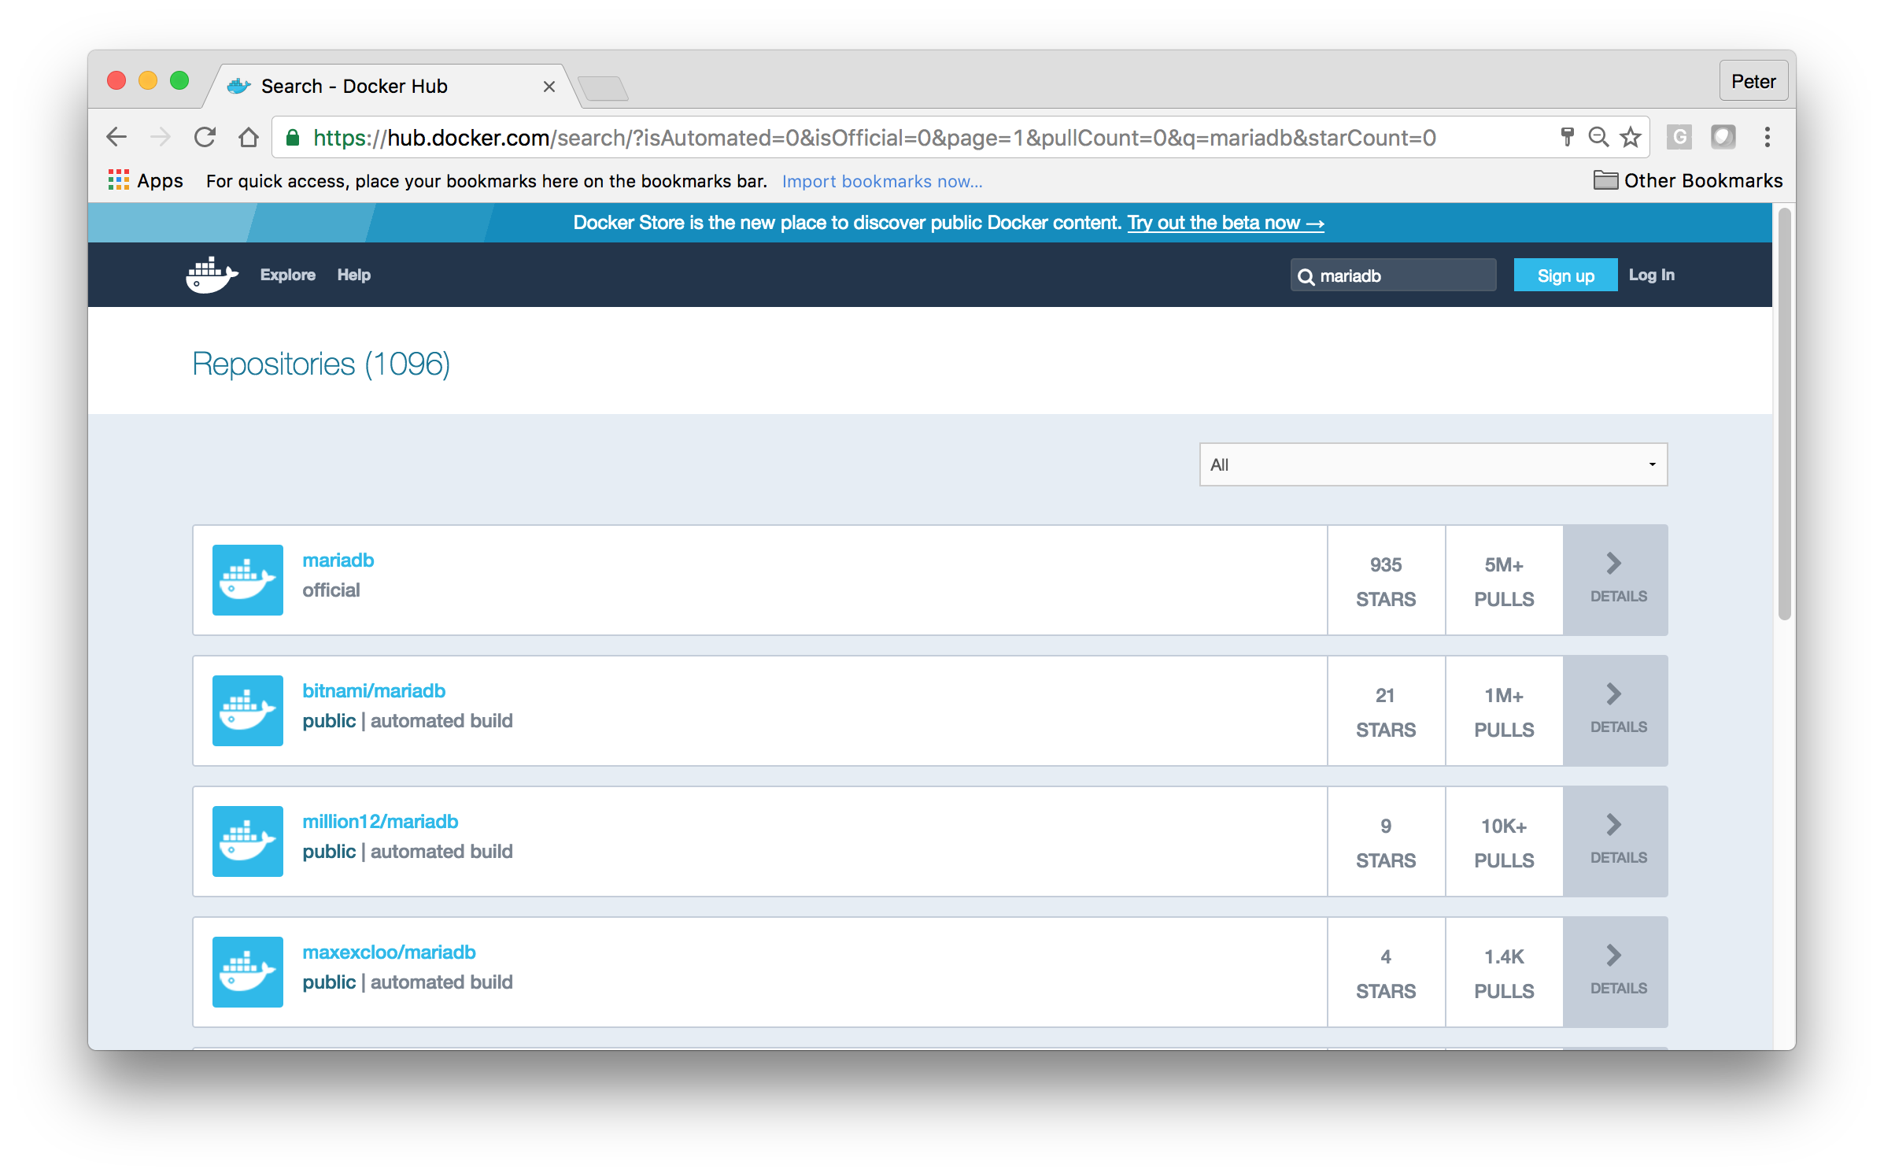
Docker Hub

Slide 49
$ Few Basic Commands
Notes:
$ docker search mariadb
Look for “Official” images.
Look for images that the community upvotes with “Stars”

Slide 50
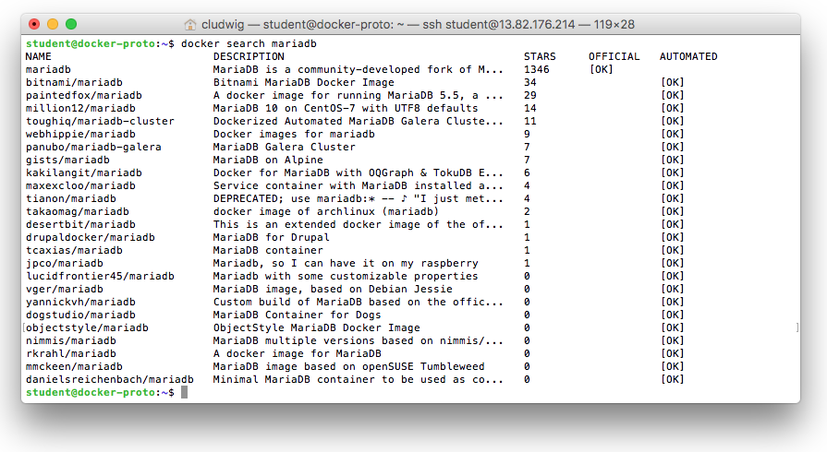
$ docker search [searchterm]
Notes:
$ docker search mariadb
Look for “Official” images.
Look for images that the community upvotes with “Stars”

Slide 51
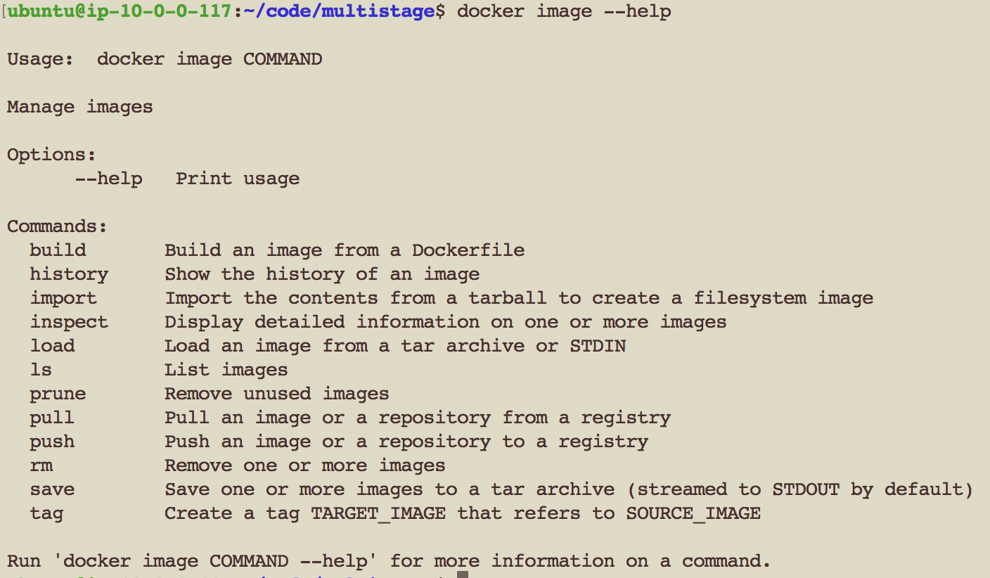
Docker image commands

Slide 52
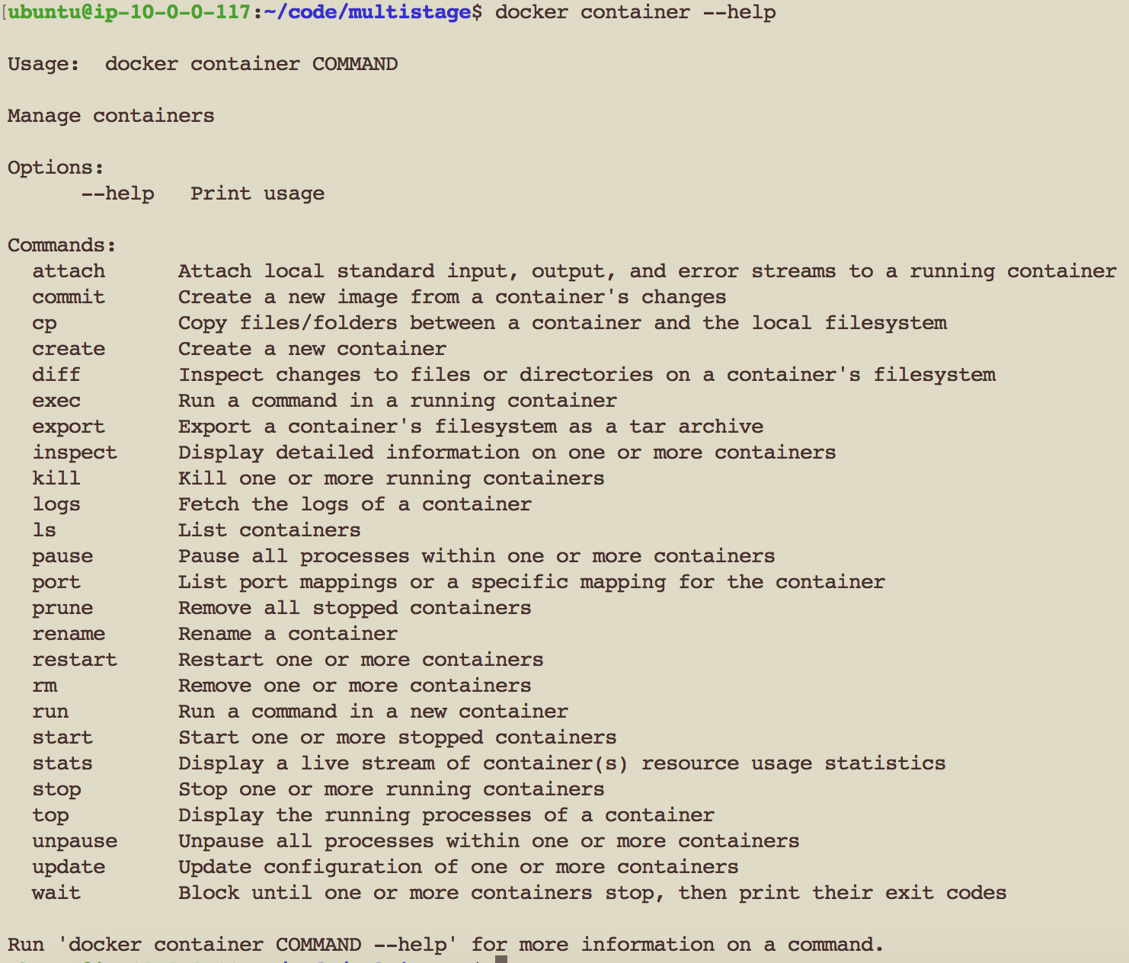
Docker Container commands

Slide 53
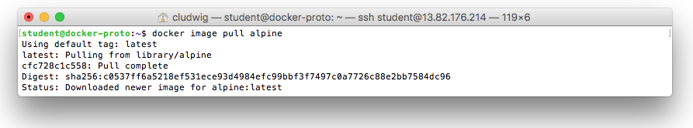
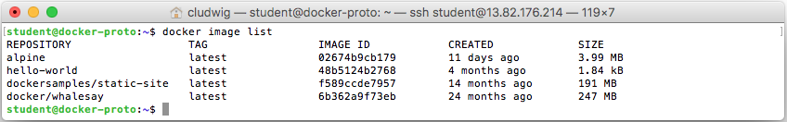
$ docker image pull [imageName]
Best Practice: Choose the smallest base images possible
Debian – 123 MB
Alpine – 5 MB

Slide 54
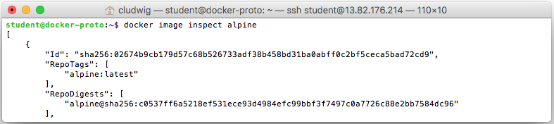
$ docker inspect [image|container]
ID The unique identifier for the container
State This stanza has various status flags and the process id for the container. Using the ExitCode from this State element a graceful shutdown or recovery process could be initiated. The following format will return just the ExitCode of the most recently run container:
docker inspect -f '{{.State.ExitCode}}' $(docker ps -lq)
Image The image this container is running.
NetworkSettings The network environment for the container and therefore for the application(s) within the image.
LogPath The system path to this container's log file.
RestartCount Keeps track of the number of times the container has been restarted. This value is the key value used when defining a container's restart policy..
Name The user defined name for the container.
Volumes Defines the volume mapping between the host system and the container.
HostConfig Key configurations for how the container will interact with the host system. These could take CPU and memory limits, networking values, or device driver paths.
Config The runtime configuration options set when the docker run command was executed. Part of this configuration is another "Image" value. This image {{.Config.Image}} is the tagged image which may be different than the image listed in {{.Image}}
Notes:
It can be useful to narrow down information from docker inspect with grep as well

Slide 55
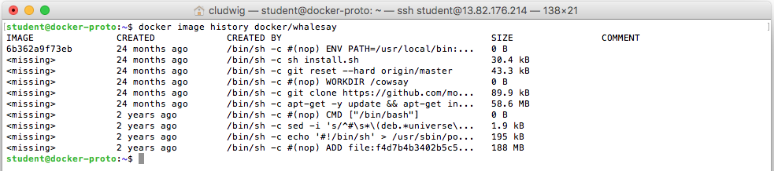
$ docker image history docker/whalesay
Use history to view layers in an image

Slide 56
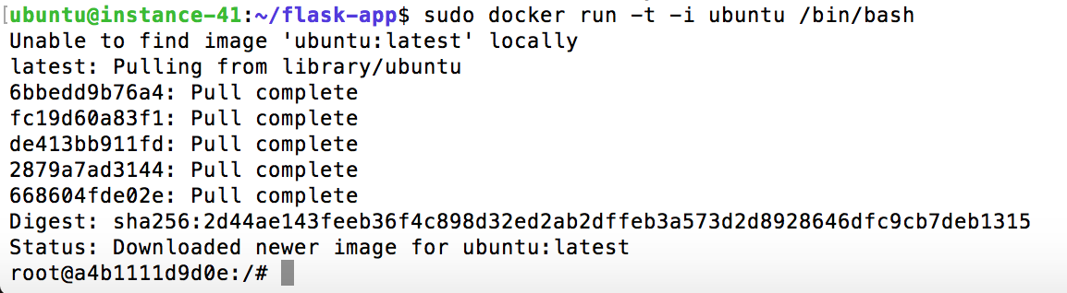
Docker Interactive Mode
Best Practice: Run containers in interactive mode while developing docker images

Slide 57
Docker Interactive Mode
Create a terminal
To use
docker run -t -i ubuntu /bin/bash
Interactive mode
Notes:
As we’ve seen, we can combine these two options to the more common -it

Slide 58
Docker Interactive Mode
Attach to a running container and shell instance
docker attach some_container #by Name
Attach to a running container by starting a new shell instance
docker exec -it some_container /bin/bash #by Name

Slide 59
Docker Interactive Mode
Quick Tip: Be aware that alpine and other distros may have a different entry point (sh vs bash)
docker run -it alpine /bin/sh

Slide 60
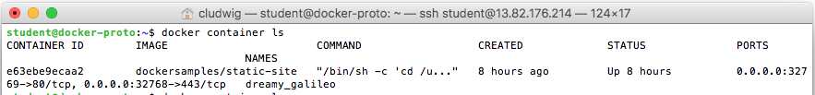
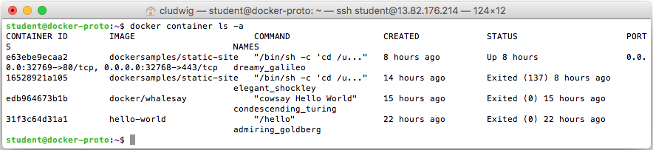
See all containers
$ docker container ls #show running containers
$ docker container ls -a #show all containers (including running, stopped, exited, etc.)

Slide 61
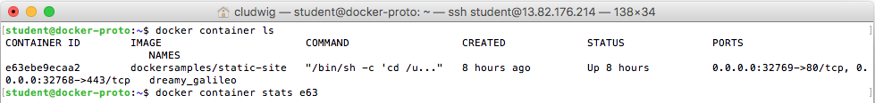
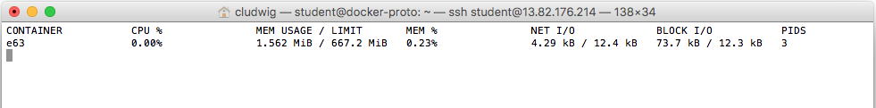
$docker container stats
Provides the CPU, memory, network, and other monitoring KPI’s of a docker container.
Multiple containers can be profiled as well
All containers can be profiled by leaving out the container id(s)

Slide 62
Removing Docker Containers & Images
#!/bin/bash
# Remove all stopped containers
docker container prune [-f]
# Remove all unused images
docker image prune [-f] [-a]
-f option skips confirmation.
-a option (for images) removes ALL unused images, not just those that were left behind when a container was removed (dangling).
Best Practice: Prevent image inflation and regularly clean up images

Slide 63
Docker Working with Images and Containers
CLASSROOM WORK 2.1
45 minutes
Practice Docker image and container commands
https://github.com/shekhar2010us/microservices_monolithic_docker/blob/master/docker_image_container.md
Notes:
https://github.com/docker/labs/blob/master/beginner/chapters/webapps.md

Slide 64
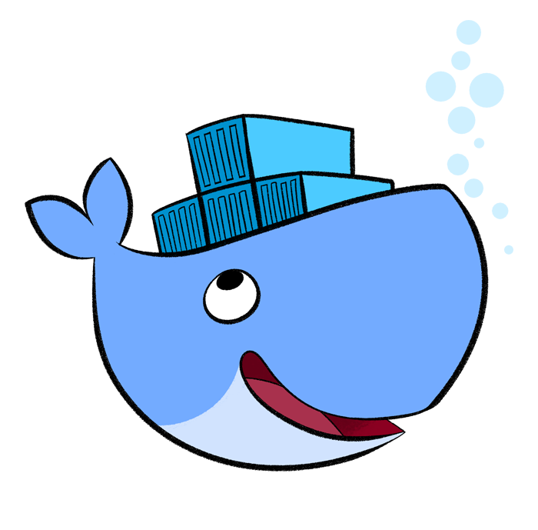
Docker Files
Part 3: DevOps Docker

Slide 65
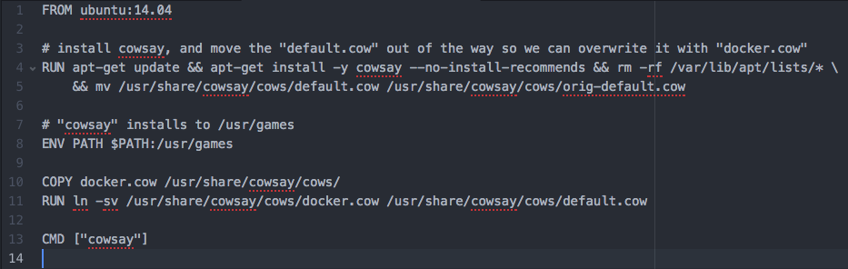
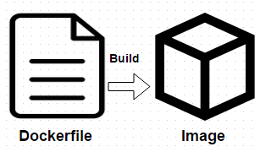
Dockerfile
Docker images are built, layer by layer, from a base image
Images are composed of layers, each with a simple command such as
Run a shell command
Add a file or directory
Create an environment variable
Modify permissions
Execute process or script

Slide 66
Dockerfile
#Comment
INSTRUCTION arguments
Dockerfile format
Command | Description
FROM | The base image to use in the build. This is mandatory and must be the first command in the file
MAINTAINER | An optional value for the maintainer of the script
RUN | Executes a command and save the result as a new layer This executes during build time
CMD | The command that runs when the container starts Doesn’t execute during built time whereas RUN executes during build time
ENV | Sets an environment variable in the new container
COPY | Copies a file from source to destination in the file system of the container
ADD | Remote URL support and Copies a file from the host system onto the container
ENTRYPOINT | Primary command to run whenever the image is executed
EXPOSE | Opens a port for linked containers
ONBUILD | A command that is triggered when the image in the Dcokerfile is used as a base for another image It behaves as if a RUN instruction is inserted immediately after the FROM instruction of the downstream Dockerfile
USER | Sets the default user within the container
VOLUME | Creates a shared volume that can be shared among containers or by the host machine
WORKDIR | Set the default working directory for the container for other instructions like RUN, CMD, COPY, ADD, ENTRYPOINT
LABEL | Add metadata to the image; LABEL key=value

Slide 67
Dockerfile
FROM command
The first instruction in a Dockerfile is a FROM command, to specify the Image from which you are building from.
FROM <image>
FROM <Image>:<tag>
FROM ubuntu:14.04

Slide 68
Dockerfile
MAINTAINER command
This lets you know who to consult (or blame ☺) for any dockerfile issues
MAINTAINER Santa Claus “santa@abc.org”
ENV command
Used to provide environment variables for containers.
ENV <key> <value>
ENV PATH $PATH:/usr/foo

Slide 69
Dockerfile
RUN command
Executes commands and commits the results in a new layer.
RUN <command>
RUN apt-get update
CMD command
Can only be one in a dockerfile. The CMD instruction provides defaults to an executing container and can be overridden with arguments to docker run.
CMD [“cowsay”]

Slide 70
Dockerfile
ADD/COPY command
Places files onto a file system. ADD performs the same as copy, but also allows the <src> to be a URL. It will also unpack recognized compression formats.
COPY <src> <dest>
ADD <src> <dest>
EXPOSE command
Informs Docker that the container listens on a network port at runtime. Ports of a container are still not accessible to the host unless –p flag is passed to the Docker run command when the container is invoked.
EXPOSE 80

Slide 71
Dockerfile
Best Practices for writing Dockerfiles:
Use .dockerignore to exclude any unnecessary files and improve Docker’s performance
Run a single process per container to simplify scale and reuse
Minimize layers per container
Sharing base images is a common among development teams
When possible, base from tiny images such as Alpine Linux
For production: specify version of the base image (do not use latest)
For production: use image sha digest rather than image name
Notes:
More here: https://docs.docker.com/engine/userguide/eng-image/dockerfile_best-practices/

Slide 72
Dockerfile
Dockerfile build syntax
docker build .
docker build -t <namespace/image name:versiontag> /path
docker build -t myimage/kafka .
** Be aware that when you run ’docker build .’, all files in the current folder get uploaded to docker engine. This may be undesirable, and use of .dockerignore will assist with this situation.
Then run the newly created image
Docker run –t myname/jenkins
Notes:
-t (--tag): assign tag
Be aware that when you run ’docker build .’, all files in the current folder get uploaded to docker engine. This may be undesirable, and use of .dockerignore will assist with this situation.

Slide 73
Docker Create your first image
CLASSROOM WORK 3.1
45 minutes
https://github.com/shekhar2010us/microservices_monolithic_docker/blob/master/docker_create_image.md
Notes:
https://github.com/docker/labs/blob/master/beginner/chapters/webapps.md

Slide 74
Dockerfile Exercises
CLASSROOM WORK 3.2
30 minutes
Exercise 2.2 & 2.3 in Docker Labs
https://github.com/docker/labs/blob/master/beginner/chapters/webapps.md
NB: You can skip the second part of step 2.3.4 (“Push Your Image”) unless you want to first create yourself an account at hub.docker.com.
Notes:
https://github.com/docker/labs/blob/master/beginner/chapters/webapps.md

Slide 75
Dockerfile Optimization
CLASSROOM WORK 3.3
10 minutes
This exercise covers optimizing dockerfile to reduce the number of layers
https://github.com/docker/dceu_tutorials/blob/master/11-infrastructure-as-code.md
Notes:
https://github.com/docker/dceu_tutorials/blob/master/11-infrastructure-as-code.md

Slide 76
Multi-stage Build
Multi-Stage Build
Image 1
Image 2
Stage 1
Stage 2
Shell Script
Application
Application
Builder Pattern
Multi Stage Build
Builder Pattern: Common practice to maintain two dockerfiles. One for development and other for production that contains application and only things needed to run the application
This is not ideal !!!!
Multi-Stage Build: One stage to another
Notes:
https://github.com/codeship/go-hello-world

Slide 77
Multi-stage Build
New as of Docker 17.05
Allows “ship artifacts, not build environments”
Ideal for languages like Go, where binaries are built in a heavyweight environment, but can ship the binary in a lightweight container.
# first stage does the building
# for UX purposes, I'm naming this stage `build-stage`
FROM golang:1.8 as build-stage
WORKDIR /go/src/github.com/codeship/go-hello-world
COPY hello-world.go .
RUN go build -o hello-world .
# starting second stage
FROM alpine:latest
# copy the binary from the `build-stage`
COPY --from=build-stage /go/src/github.com/codeship/go-hello-world/hello-world /bin
CMD hello-world
$ docker images
REPOSITORY TAG IMAGE ID CREATED SIZE
single-stage latest 58328409dbf7 2 minutes ago 704MB
multi-stage latest 9af3c2a2bf40 23 minutes ago 5.54MB
Notes:
https://github.com/codeship/go-hello-world

Slide 78

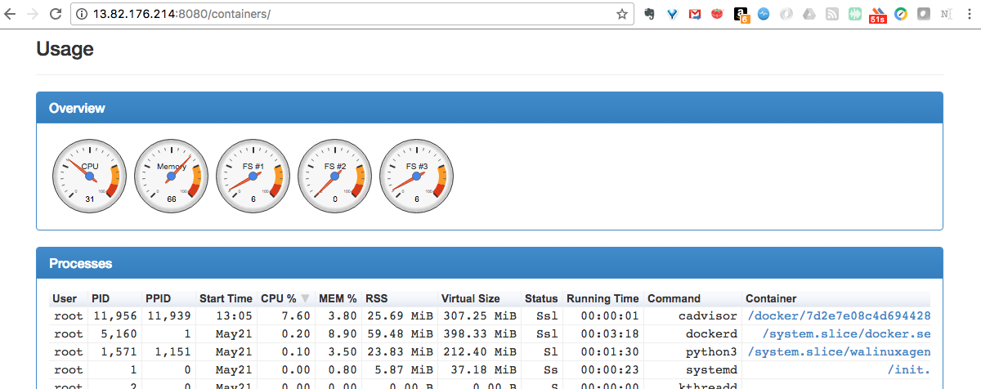
Docker Monitoring
https://github.com/google/cadvisor - Monitor the system from inside the Docker container!
sudo docker run --volume=/:/rootfs:ro --volume=/var/run:/var/run:rw --volume=/sys:/sys:ro --volume=/var/lib/docker/:/var/lib/docker:ro --publish=8080:8080 --detach=true --name=cadvisor1 google/cadvisor:latest
yourdockerhost:8080
Notes:
https://github.com/google/cadvisor

Slide 79
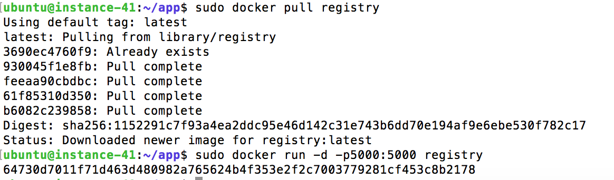
Running a Private Docker Registry
docker run -d –p 5000:5000 registry
Push/Pull enabled from private registry

Slide 80
Docker Registry
Tag an image
docker tag ubuntu localhost:5000/myubuntu:0.1
Push the tagged image to registry
docker push localhost:5000/myubuntu:0.1
Verify the pushed image
docker rmi –f ubuntu
docker rmi –f localhost:5000/myubuntu:0.1
docker pull localhost:5000/myubuntu:0.1
Run a container from the above image
Notes:
https://github.com/docker/docker.github.io/blob/master/registry/deploying.md

Slide 81
Docker Registry Search
Search Registry
https://docs.docker.com/registry/spec/api/#listing-repositories
curl -XGET http://localhost:5000/v2/_catalog
List Image Tags
https://docs.docker.com/registry/spec/api/#listing-image-tags
curl -XGET http://localhost:5000/v2/myubuntu/tags/list
Notes:
https://docs.docker.com/registry/spec/api/#listing-repositories
https://docs.docker.com/registry/spec/api/#listing-image-tags

Slide 82
Docker Monitoring/Registry Exercise
CLASSROOM WORK
20 minutes
https://github.com/shekhar2010us/microservices_monolithic_docker/blob/master/docker_monitor_registry.md
Notes:
This is a nice full volumes exercise that shows volume persistence, cross-container volumes, etc.
https://github.com/docker/dceu_tutorials/blob/master/07-volumes.md

Slide 83
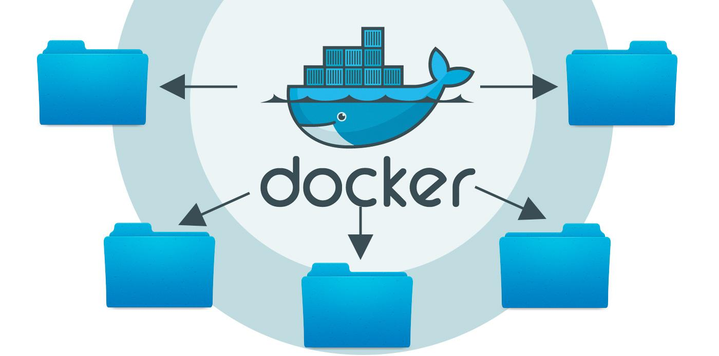
Docker Volumes
Part 4: DevOps Docker

Slide 84
Data volumes
A data volume is a specially-designated directory within one or more containers that bypasses the Union File System. Data volumes provide several useful features for persistent or shared data:
Volumes are initialized when a container is created. If the container’s base image contains data at the specified mount point, that existing data is copied into the new volume upon volume initialization. (Note that this does not apply when mounting a host directory.)
Data volumes can be shared and reused among containers.
Changes to a data volume are made directly.
Changes to a data volume will not be included when you update an image.
Data volumes persist even if the container itself is deleted.
Data volumes are designed to persist data, independent of the container’s lifecycle. Docker therefore never automatically deletes volumes when you remove a container, nor will it “garbage collect” volumes that are no longer referenced by a container.

Slide 85
Adding a data volume
You can add a data volume to a container using the -v flag with the docker create and docker run command. You can use the -v multiple times to mount multiple data volumes. Now, mount a single volume in your web application container.
docker run -it --name test1 –v data2:/data ubuntu
You can share volumes from one container to another using volumes-from tag
In addition to creating a volume using the -v flag you can also mount a directory from your Docker engine’s host into a container
docker run -it --name test1 -v /home/ubuntu/src:/data ubuntu
This command mounts the host directory, /home/ubuntu/src, into the container at /data.

Slide 86
Docker volume commands
Command | Description
docker volume create | Create a volume
docker volume ls | List volumes
docker volume inspect | Detailed information on volume
docker volume rm | Remove volume

Slide 87
Working with Volumes (docker volumes)
ubuntu@ip-172-31-35-117:~$ docker volume ls
DRIVER VOLUME NAME
local 0aaf0f814ce772146fbbbfbe8d67da39bc00e25d7f728a3a43b1f7080499342b
local 4e37dd17754c6f0ba9f43ebc8052be0c18db1c5b56b44f539b283406afc35e5c
local b5f8b253293cc20b10133335eed74848fbf466b5d055fa5e3b16976766a4c618
ubuntu@ip-172-31-35-117:~$
ubuntu@ip-172-31-35-117:~$ docker volume create myvolume
myvolume
ubuntu@ip-172-31-35-117:~$ docker volume ls
DRIVER VOLUME NAME
local 0aaf0f814ce772146fbbbfbe8d67da39bc00e25d7f728a3a43b1f7080499342b
local 4e37dd17754c6f0ba9f43ebc8052be0c18db1c5b56b44f539b283406afc35e5c
local b5f8b253293cc20b10133335eed74848fbf466b5d055fa5e3b16976766a4c618
local myvolume
ubuntu@ip-172-31-35-117:~$ docker volume inspect myvolume
[{
"Driver": "local",
"Labels": {},
"Mountpoint": "/var/lib/docker/volumes/myvolume/_data",
"Name": "myvolume",
"Options": {},
"Scope": "local"
}]

Slide 88
Working with Volumes (docker volumes)
ubuntu@ip-172-31-35-117:~$ docker run -it -v myvolume:/myvolume --name vlab nginx /bin/bash
root@5476f2fa7f09:/# cd myvolume/
root@5476f2fa7f09:/myvolume# ls
root@5476f2fa7f09:/myvolume#
root@5476f2fa7f09:/myvolume# echo "content from container" >> file.1
root@5476f2fa7f09:/myvolume# ls
file.1
root@5476f2fa7f09:/myvolume# exit
exit
ubuntu@ip-172-31-35-117:~$ sudo su -
root@ip-172-31-35-117:~# ll /var/lib/docker/volumes/myvolume/_data
total 12
drwxr-xr-x 2 root root 4096 Aug 7 04:19 ./
drwxr-xr-x 3 root root 4096 Aug 7 04:18 ../
-rw-r--r-- 1 root root 23 Aug 7 04:19 file.1
root@ip-172-31-35-117:~# cat /var/lib/docker/volumes/myvolume/_data/file.1
content from container
root@ip-172-31-35-117:~# exit
logout

Slide 89
Working with Volumes (absolute path)
ubuntu@ip-172-31-35-117:~$ mkdir data_dir
ubuntu@ip-172-31-35-117:~$ echo "file.1" >> data_dir/file.1
ubuntu@ip-172-31-35-117:~$ echo "file.2" >> data_dir/file.2
ubuntu@ip-172-31-35-117:~$ ll data_dir/
total 16
drwxrwxr-x 2 ubuntu ubuntu 4096 Aug 7 04:25 ./
drwxr-xr-x 7 ubuntu ubuntu 4096 Aug 7 04:25 ../
-rw-rw-r-- 1 ubuntu ubuntu 7 Aug 7 04:25 file.1
-rw-rw-r-- 1 ubuntu ubuntu 7 Aug 7 04:25 file.2
ubuntu@ip-172-31-35-117:~$
ubuntu@ip-172-31-35-117:~$ docker run -it -v /home/ubuntu/data_dir:/mydata --name vlab2 nginx /bin/bash
root@4fd5e542d67c:/# ll mydata/
bash: ll: command not found
root@4fd5e542d67c:/# ls mydata/
file.1 file.2
root@4fd5e542d67c:/# cat mydata/file.1
file.1
root@4fd5e542d67c:/# exit
exit

Slide 90
Working with Volumes (--volumes-from)
ubuntu@ip-172-31-35-117:~$ docker volume create --name backup
backup
ubuntu@ip-172-31-35-117:~$ docker volume create --name logs
logs
ubuntu@ip-172-31-35-117:~$ docker run -it --name master -v backup:/backup -v logs:/logs ubuntu bash
root@cc963e4d24b9:/# echo "back up content" >> backup/back.file
root@cc963e4d24b9:/# echo "log file content" >> logs/log.file
root@cc963e4d24b9:/# exit
exit
ubuntu@ip-172-31-35-117:~$ docker run -it --name slave --volumes-from master ubuntu bash
root@f027d96030ba:/# ll backup/
total 12
drwxr-xr-x 2 root root 4096 Aug 7 04:30 ./
drwxr-xr-x 1 root root 4096 Aug 7 04:31 ../
-rw-r--r-- 1 root root 16 Aug 7 04:30 back.file
root@f027d96030ba:/# ll logs/
total 12
drwxr-xr-x 2 root root 4096 Aug 7 04:30 ./
drwxr-xr-x 1 root root 4096 Aug 7 04:31 ../
-rw-r--r-- 1 root root 17 Aug 7 04:30 log.file
root@f027d96030ba:/# exit
exit

Slide 91
Dangling Volumes
If container is deleted with a volume attached, the volume remains. Sometimes removing all such ‘dangling’ volumes is desired
$ docker volume prune
Notes:
$ docker volume prune

Slide 92
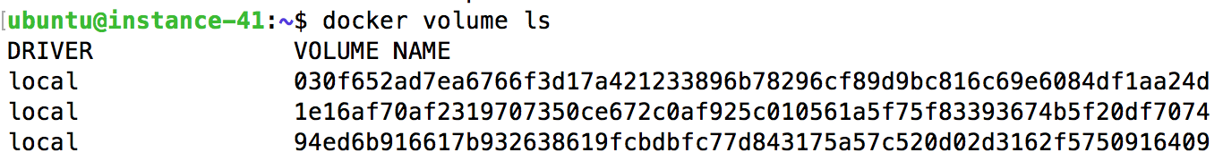
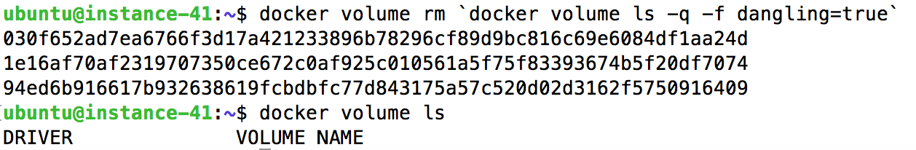
Dangling Volumes
Before
After

Slide 93
Docker Volumes Exercise
CLASSROOM WORK
30 minutes
https://goo.gl/gR6XTl
(https://github.com/docker/dceu_tutorials/blob/master/07-volumes.md)
Notes:
This is a nice full volumes exercise that shows volume persistence, cross-container volumes, etc.
https://github.com/docker/dceu_tutorials/blob/master/07-volumes.md

Slide 94
Docker --volumes-from Exercise
CLASSROOM WORK
10 minutes
volumes-from
docker volume create --name backup
docker volume create --name logs
docker run -it --name master -v backup:/backup -v logs:/logs ubuntu bash
create sample files in backup & logs folders in container
You can stop the container, but do not remove it
Create another container using master volumes
docker run -it --name slave1 --volumes-from master ubuntu bash
check the 2 folders ; exit
Notes:
This is a nice full volumes exercise that shows volume persistence, cross-container volumes, etc.
https://github.com/docker/dceu_tutorials/blob/master/07-volumes.md

Slide 95
Remote Volumes
https://container42.com/2014/03/29/docker-quicktip-4-remote-volumes/

Slide 96
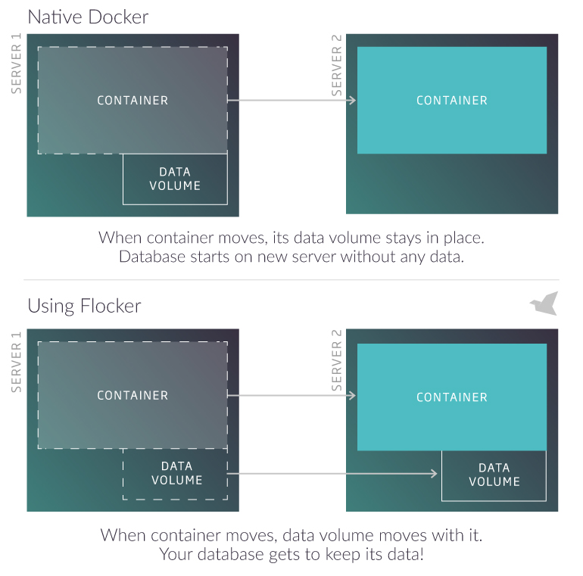
Docker Volume Plugin - Flocker
https://clusterhq.com/flocker/

Slide 97
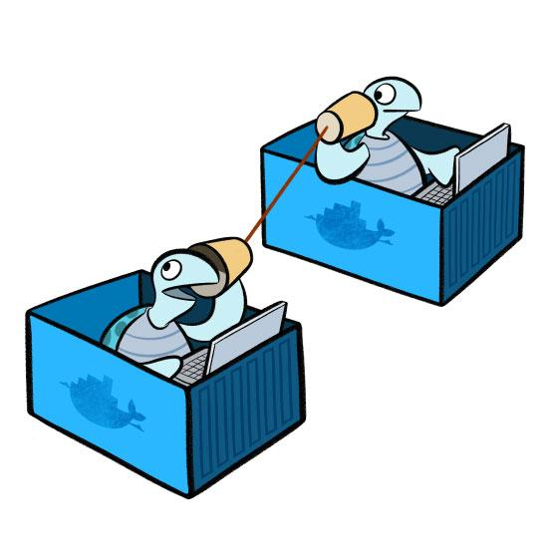
Docker Networking

Slide 98
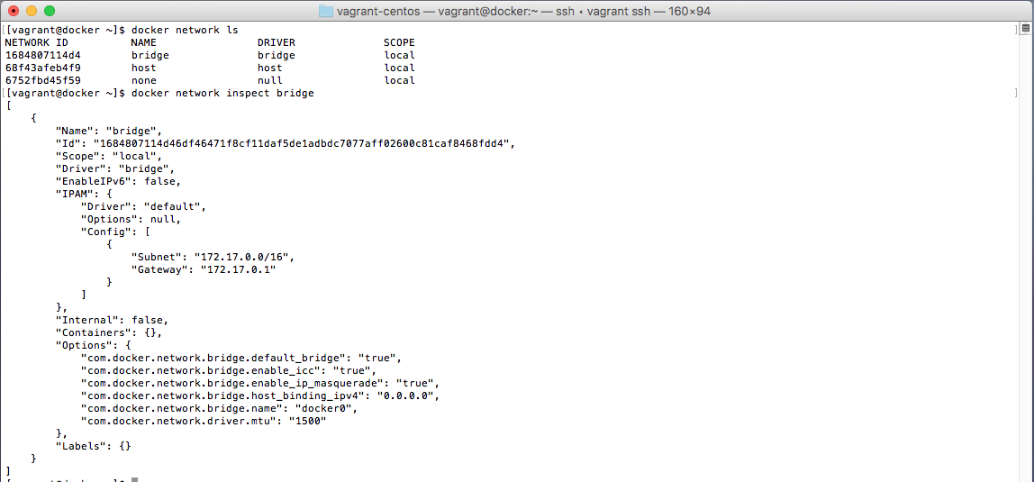
Docker Network Defaults
Three networks are created by default (bridge, host & none)
docker network ls
We can easily inspect the bridge network
docker network inspect bridge
We see that a 172.17.0.0/16 address space is allocated. Created Containers are given an IP in this space by default.
Notes:
$ docker network ls
$ docker network inspect bridge

Slide 99
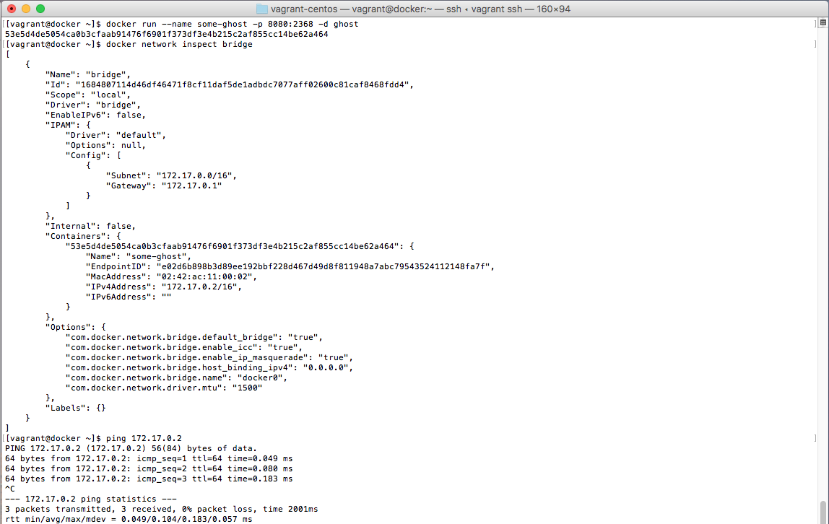
Docker Network Defaults
Created container is attached to bridge network by default
Can be attached to user created networks as well with –network flag
Container is assigned 172.17.0.2 ip in the bridge network and appears in the docker inspect command
The container can then be pinged at 172.17.0.2
Notes:
docker run --name some-ghost -p 8888:2368 -d ghost
docker inspect network bridge
ping 172.17.0.2
Note: The ‘some-ghost’ container is still exposed at <ip>:8888 through use of the –p 8888:2368 flag and argument
Read more about docker networking
https://docs.docker.com/engine/userguide/networking/

Slide 100
Docker network commands
Command | Description
docker network create | Create a network
docker network ls | List networks
docker network inspect | Detailed information on network
docker network rm | Remove network
docker network disconnect | Disconnect container from network
docker network connect | Connect container to network
Notes:
Commands follow the same general pattern as docker volume.
More documentation available at
https://docs.docker.com/engine/userguide/networking/

Slide 101
Working with Networks
Run redis container with default network
ubuntu@ip-172-31-35-117:~$ docker network ls
NETWORK ID NAME DRIVER SCOPE
bcddd713372f bridge bridge local
94a5aa84bbcd host host local
e785de4a1213 none null local
ubuntu@ip-172-31-35-117:~$ docker run -d -p 1000:6379 --name red1 redis
82233b85cb84e2372e0e3fcdf03c5f46642c8faf0e201a7b0c43f7439c2ca02e
Run ubuntu container with default network
ubuntu@ip-172-31-35-117:~$ docker run -it --name ub1 ubuntu
root@65b7ce9e6028:/# apt-get update && apt-get install -y redis-tools

Slide 102
Working with Networks
Check how to access redis container from ubuntu container → we can access
root@65b7ce9e6028:/# redis-cli -h 172.17.0.2 -p 6379
172.17.0.2:6379> set foo1 bar1
OK
172.17.0.2:6379> quit
root@65b7ce9e6028:/#
root@65b7ce9e6028:/# redis-cli -h 34.216.137.67 -p 1000
34.216.137.67:1000> get foo1
"bar1"
34.216.137.67:1000> quit
root@65b7ce9e6028:/#
root@65b7ce9e6028:/# redis-cli -h 34.216.137.67 -p 6379
Could not connect to Redis at 34.216.137.67:6379: Connection refused
Could not connect to Redis at 34.216.137.67:6379: Connection refused
not connected> quit
root@65b7ce9e6028:/#
root@65b7ce9e6028:/# redis-cli -h 172.17.0.2 -p 1000
Could not connect to Redis at 172.17.0.2:1000: Connection refused
Could not connect to Redis at 172.17.0.2:1000: Connection refused
not connected>
not connected> quit

Slide 103
Working with Networks
Create a new bridge network
ubuntu@ip-172-31-35-117:~$ docker network create bridgea
1f0afe0c3f5529403c5baa17e16e5534d0bf2f1966fd75c385902a7e97e5f61f
ubuntu@ip-172-31-35-117:~$ docker network ls
NETWORK ID NAME DRIVER SCOPE
bcddd713372f bridge bridge local
1f0afe0c3f55 bridgea bridge local
94a5aa84bbcd host host local
e785de4a1213 none null local
Run ubuntu container in the new network, install redis-tools
ubuntu@ip-172-31-35-117:~$ docker run -it --name ub2 --network bridgea ubuntu
root@34461322da59:/# apt-get update && apt-get install -y redis-tools
Redis (bridge network) is not accessible from ubuntu (bridgea) network
root@34461322da59:/# redis-cli -h 172.17.0.2 -p 6379
^Z
[2]+ Stopped redis-cli -h 172.17.0.2 -p 6379
root@34461322da59:/#

Slide 104
Working with Networks
Connect ub2 container to bridge network
ubuntu@ip-172-31-35-117:~$ docker network connect bridge ub2
ubuntu@ip-172-31-35-117:~$ docker inspect ub2
"Networks": {
"bridge": {
"Gateway": "172.17.0.1",
"IPAddress": "172.17.0.3",
},
"bridgea": {
"Gateway": "172.18.0.1",
"IPAddress": "172.18.0.2",
}
Now Redis (bridge network) is accessible from ubuntu (bridgea + bridge) network
ubuntu@ip-172-31-35-117:~$ docker attach ub2
root@34461322da59:/# redis-cli -h 172.17.0.2 -p 6379
172.17.0.2:6379> keys *
1) "foo1"
172.17.0.2:6379> get foo1
"bar1"
172.17.0.2:6379> quit

Slide 105
Docker Networks Exercise
CLASSROOM WORK
20 minutes
Run a redis container with default network
Run a ubuntu container with default network
Install redis-tools in host and check if you can connect to redis container and add some data
Install redis-tools in ubuntu container and check if you can connect to redis container. (optional: create an image with redis-tools and ubuntu)
Create a bridge network (bridgea)
Run a ubuntu container with bridgea network and the new image, check if you can connect to redis – probably not
Connect this new ubuntu container with “bridge” network, and check again if you can connect to the redis container
** keep inspecting network and container after every step
Notes:
This is a nice full volumes exercise that shows volume persistence, cross-container volumes, etc.
https://github.com/docker/dceu_tutorials/blob/master/07-volumes.md

Slide 106
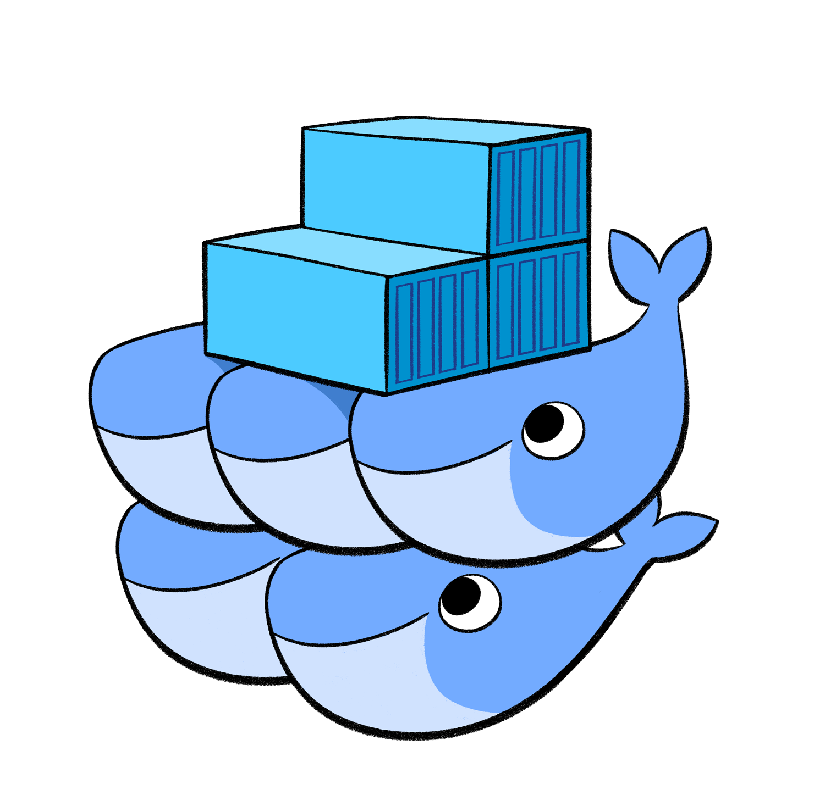
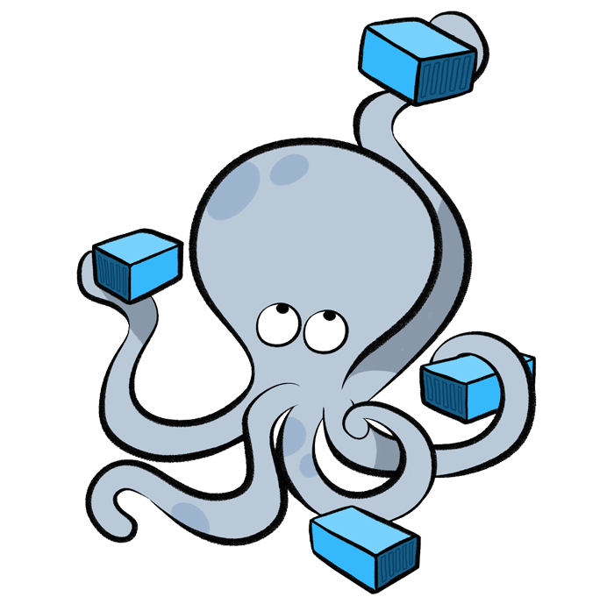
Docker Compose/Swarm
Part 5: DevOps Docker
Notes:
Swarm used to be a standalone daemon that was Docker API compatible.
Swarm is now a “mode” of the standard Docker Daemon
With Swarm now integrated directly into docker, many (if not all) use cases for stand-alone Docker Compose can now be implemented using Swarm mode. You will see that Docker labs have been updated to demonstrating clustering using Swarm instead of Compose because of the in-built ability to span Docker hosts that Swarm offers.

Slide 107
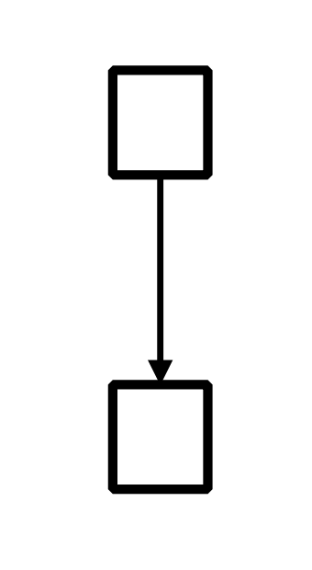
Launching multiple containers is clumsy
$ docker pull redis:latest
$ docker build -t web .
$ docker run -d --name=db redis:latest redis-server --appendonly yes
$ docker run -d --name=web --link db:db -p 5000:5000 -v `pwd`:/code web python app.py

Slide 108
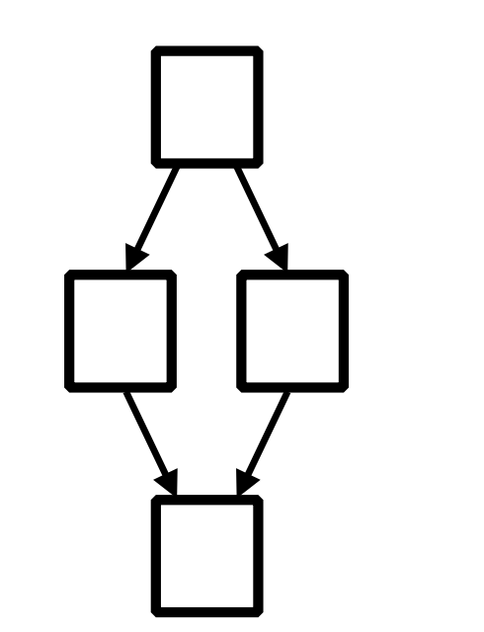
Launching multiple containers is clumsy
$ docker pull ...
$ docker pull ...
$ docker build ...
$ docker build ...
$ docker run ...
$ docker run ...
$ docker run ...
$ docker run ...

Slide 109

Docker Compose or Swarm launches app with a single command
$ docker-compose up
$ docker stack deploy

Slide 110
Docker Compose commands
Command | Description
docker-compose up | (Re)build services
docker-compose kill | Kill the containers
docker-compose logs | Show the logs of the containers
docker-compose down | Stop and remove images, containers, volumes and networks
docker-compose rm | Remove stopped containers

Slide 111
Docker Compose to deploy a cluster
CLASSROOM WORK
First, install Compose:
https://github.com/docker/compose/releases
sudo curl -L https://github.com/docker/compose/releases/download/1.22.0/docker-compose-`uname -s`-`uname -m` -o /usr/local/bin/docker-compose
sudo chmod +x /usr/local/bin/docker-compose
docker-compose version
Then, Compose “Getting Started” Lab:
https://docs.docker.com/compose/gettingstarted/
Notes:
sudo curl -L https://github.com/docker/compose/releases/download/1.16.1/docker-compose-`uname -s`-`uname -m` -o /usr/local/bin/docker-compose
sudo chmod +x /usr/local/bin/docker-compose
docker-compose --version
This exercise shows how docker-compose can be used to deploy a multi-container app in one step against a single docker daemon. Very useful for development, test, and CI environments.

Slide 112
Docker Swarm commands
Command | Description
docker swarm init | Create a swarm
docker stack deploy | Deploy the swarm
docker stack services | Show swarm services
docker stack rm | Remove stack

Slide 113

Docker Swarm to deploy a cluster
CLASSROOM WORK
Exercise 3.0 in Docker Labs
https://github.com/docker/labs/blob/master/beginner/chapters/votingapp.md
Notes:
Imagine what it would take to support something like American Idol’s voting system… you’d probably define a similar architecture.

Slide 114

Docker Security
Part 7: DevOps Docker

Slide 115
Security For Docker Images
Getting trustworthy images
Trusted Content
Pull by sha
Docker Bench Security
Docker Trusted Registry
Docker Security scanning
Clair by CoreOS

Slide 116
Trusted Content
ubuntu@ip-172-31-35-117:~$ docker images
REPOSITORY TAG IMAGE ID CREATED SIZE
ubuntu@ip-172-31-35-117:~$ export DOCKER_CONTENT_TRUST=1
ubuntu@ip-172-31-35-117:~$ docker pull alpine:latest
Pull (1 of 1): alpine:latest@sha256:7043076348bf5040220df6ad703798fd8593a0918d06d3ce30c6c93be117e430
sha256:7043076348bf5040220df6ad703798fd8593a0918d06d3ce30c6c93be117e430: Pulling from library/alpine
8e3ba11ec2a2: Pull complete
Digest: sha256:7043076348bf5040220df6ad703798fd8593a0918d06d3ce30c6c93be117e430
Status: Downloaded newer image for alpine@sha256:7043076348bf5040220df6ad703798fd8593a0918d06d3ce30c6c93be117e430
Tagging alpine@sha256:7043076348bf5040220df6ad703798fd8593a0918d06d3ce30c6c93be117e430 as alpine:latest
ubuntu@ip-172-31-35-117:~$
ubuntu@ip-172-31-35-117:~$ docker pull tenstartups/alpine
Using default tag: latest
Error: remote trust data does not exist for docker.io/tenstartups/alpine: notary.docker.io does not have trust data for docker.io/tenstartups/alpine
ubuntu@ip-172-31-35-117:~$
ubuntu@ip-172-31-35-117:~$ export DOCKER_CONTENT_TRUST=0
ubuntu@ip-172-31-35-117:~$ docker pull tenstartups/alpine
Using default tag: latest
latest: Pulling from tenstartups/alpine
ff3a5c916c92: Pull complete
938de623aa55: Pull complete
Digest: sha256:31dc8b12e0f73a1de899146c3663644b7668f8fd198cfe9b266886c9abfa944b
Status: Downloaded newer image for tenstartups/alpine:latest
ubuntu@ip-172-31-35-117:~$

Slide 117
Trusted Content
ubuntu@ip-172-31-35-117:~$ docker images
REPOSITORY TAG IMAGE ID CREATED SIZE
ubuntu@ip-172-31-35-117:~$ export DOCKER_CONTENT_TRUST=0
ubuntu@ip-172-31-35-117:~$ docker pull alpine:latest
latest: Pulling from library/alpine
8e3ba11ec2a2: Pull complete
Digest: sha256:7043076348bf5040220df6ad703798fd8593a0918d06d3ce30c6c93be117e430
Status: Downloaded newer image for alpine:latest
ubuntu@ip-172-31-35-117:~$
ubuntu@ip-172-31-35-117:~$ docker rmi -f alpine:latest
Untagged: alpine:latest
Untagged: alpine@sha256:7043076348bf5040220df6ad703798fd8593a0918d06d3ce30c6c93be117e430
Deleted: sha256:11cd0b38bc3ceb958ffb2f9bd70be3fb317ce7d255c8a4c3f4af30e298aa1aab
Deleted: sha256:73046094a9b835e443af1a9d736fcfc11a994107500e474d0abf399499ed280c
ubuntu@ip-172-31-35-117:~$
ubuntu@ip-172-31-35-117:~$ export DOCKER_CONTENT_TRUST=1
ubuntu@ip-172-31-35-117:~$ docker pull alpine:latest
Pull (1 of 1): alpine:latest@sha256:7043076348bf5040220df6ad703798fd8593a0918d06d3ce30c6c93be117e430
sha256:7043076348bf5040220df6ad703798fd8593a0918d06d3ce30c6c93be117e430: Pulling from library/alpine
8e3ba11ec2a2: Pull complete
Digest: sha256:7043076348bf5040220df6ad703798fd8593a0918d06d3ce30c6c93be117e430
Status: Downloaded newer image for alpine@sha256:7043076348bf5040220df6ad703798fd8593a0918d06d3ce30c6c93be117e430
Tagging alpine@sha256:7043076348bf5040220df6ad703798fd8593a0918d06d3ce30c6c93be117e430 as alpine:latest
ubuntu@ip-172-31-35-117:~$

Slide 118
Docker Content Trust
CLASSROOM WORK
In this exercise, we’ll learn how to enable Docker Content Trust and sign images.
https://github.com/docker/labs/blob/master/security/trust/README.md
(Skip Step 5)

Slide 119

Docker Bench Security
Docker Bench is an automated script that checks for dozens of best-practices around deploying Docker in production
https://github.com/docker/docker-bench-security
Run with the following command (available at the github page above)
docker run -it --net host --pid host --cap-add audit_control \
-v /var/lib:/var/lib \
-v /var/run/docker.sock:/var/run/docker.sock \
-v /usr/lib/systemd:/usr/lib/systemd \
-v /etc:/etc --label docker_bench_security \
docker/docker-bench-security
Notes:
1.1 – Creating a separate partition for containers – mapping /var/lib/docker to a separate partition
2.1 – Restricting network traffic – pass icc=false to the Docker daemon startup process
2.5 – Do not use the aufs storage driver – Use the appropriate storage driver for the OS of the Docker host
4.1 - Create a user for the container – Run containers as non-root users
5.7 – Do not run ssh within containers – Use tools provided by Docker to access containers including docker exec, etc

Slide 120

Security
10-15 Minutes
Docker Bench Results
Discussion
https://www.nearform.com/blog/securing-docker-containers-on-aws/
https://www.cisecurity.org/cis-benchmarks/
https://github.com/shekhar2010us/aws_key/blob/master/CIS_Docker_Community_Edition_Benchmark_v1.1.0.pdf
Notes:
If time allows review Docker Security white paper
https://d3oypxn00j2a10.cloudfront.net/assets/img/Docker%20Security/WP_Intro_to_container_security_03.20.2015.pdf
Points to consider:
Security is one of the most difficult areas of IT for which to prescribe solutions
Security is often misunderstood or de-prioritized by the business
Which is the strongest recommendation from the Docker Bench Results list? Most surprising?
Which, if any, do you disagree with?

Slide 121
(Some) Docker Security Best Practices
Docker containers can attach to volumes in read only mode with :ro option
Docker run –d –v /some/volume:ro jenkins
Start Docker containers with the -u flag so that they run as an ordinary user instead of root.
Mitigate by limiting CPU, RAM, Sockets that each container can consume
Use secure computing (seccomp) to block system calls at kernel level. Use strace to determine kernel calls made, then create a profile file in json format and start the container using that profile file
docker run --rm -it --security-opt seccomp=custom_profile.json custom_app
Log to stdout / stderr - so you can see with docker logs and docker can move to syslogs (for capture/rotate by ELK, etc.)
docker inspect --format='{{.LogPath}}' <containerid> => push to ELK for monitoring
Notes:
http://training.play-with-docker.com/security-seccomp/

Slide 122
Docker Security Scanning
(formerly Project Nautilus)
Docker Security Scanning conducts binary level scanning of your images before they are deployed, provides a detailed bill of materials (BOM) that lists out all the layers and components, continuously monitors for new vulnerabilities, and provides notifications when new vulnerabilities are found.
Available for private Docker Hub repositories (potentially free)
Available as a paid service to Docker Cloud customers, maintainers of “Official” repositories on Docker Hub, and Docker EE Advanced
https://github.com/docker/labs/blob/master/security/scanning/README.md
Notes:
https://github.com/docker/labs/blob/master/security/scanning/README.md

Slide 123
Clair by CoreOS
Robust free and open source image security scanning tool
https://github.com/coreos/clair
Static analysis of images for known vulnerabilities
Integrates into CI pipelines
Notes:
https://blog.quay.io/security­ scanning­beta/
https://coreos.com/blog/vulnerability­analysis­for­ containers/

Slide 124

Docker Patterns
Part 6: DevOps Docker

Slide 125

Docker Patterns
Notes:
How docker can be used to solve a real world problem, here are few examples.

Slide 126

Jenkins Continuous Integration-Cloudbees
Link to Blog: Clustering Jenkins
http://bit.ly/2a092Xo
Notes:
Kubernetes – manage docker containers as a cluster. – by google
The gist is that Jenkins master runs from a Docker image and is part of a Kubernetes Jenkins cluster. The master itself must have its own persistent storage where the $JENKINS_HOME with all of its credentials, plugins, and job/system configurations can be stored. This separation of master and $JENKINS_HOME into 2 locations allows the master to be fungible and therefore easily replaced should it go offline and need to be restarted by Kubernetes. The important “guts” that make a master unique all exist in the $JENKINS_HOME and can be mounted to the new master container on-demand. Kubernetes own load balancer then handles the re-routing of traffic from the dead container to the new one.

Slide 127

According to Michael Duke
Link to Blog: Docker as Jenkins Build Solution
http://bit.ly/2a57Za8
Notes:
This blog post describes using the Docker Plugin for Jenkins to allow Jenkins to provision new containers which act as Jenkins slaves and compile code for a particular version of the popular Hybris eCommerce platform.
This solved several problems:
Hybris can only compile one application at a time, so developers often ended up waiting in queues (up to 45+ minutes) to see the result of the code in the application.
Hybris cannot cross-compile applications for different versions of the platform, so separate slaves are required for each version
Using Docker solves these problems by allowing a new lightweight application server to be spun up for each code commit… the container contains the correct version of Hybris for the branch the code comes from as well as a Jenkins slave to start the compilation.

Slide 128

According to Julia Mateo
Link to Presentation: Continuous Delivery
http://bit.ly/2aHZj9o
Notes:
Nexus – maven repo manager
Sonar – code metrics server
This presentation describes a workflow for true Continuous Deployment using Jenkins with the Docker plugin to publish images and the SSH plugin to pull images onto production environments. The code must first pass code quality tests in SonarQube (formerly Sonar) and artifacts are stored using Nexus. A Blue/Green / Canary routing model allows new code to be gradually moved to the bulk of users, and allows for user-selection of application version, if desired.

Slide 129

Docker and Jenkins
Docker and Jenkins, a popular open source continuous integration tool, is a fairly common pattern, enough so that it is worth going into an example.
Spin up Jenkins in a Docker Container
Enable Jenkins to create other containers on the Docker Host computer
Notes:
It would be useful to orchestrate Docker containers with an automation tool. This allows us to create a variety of helpful automation including continuous integration pipelines for example.
In order to do so, we must figure out how to create containers from another application. Next we will walk through an example to do so.

Slide 130
How to run a ‘Host’ Docker command inside a ‘Client’ Docker container?
Mount a Docker socket
Issuing a Docker run command with the Docker socket will enable you to manage host containers from within the client container
‘docker run –v /var/run/docker.sock:/var/run/docker.sock’
Notes:
You can run the following command if you would like a fully functional example of this behavior.
docker run -it -v /var/run/docker.sock:/var/run/docker.sock ubuntu:latest sh -c "apt-get update ; apt-get install docker.io -y ; bash"
Once in this container, you can execute docker commands on the host such as ‘docker ps’ or ‘docker run ubuntu /bin/echo 'Hello world’’
Remember our syntax from docker volumes, this is mapping the host /var/run/docker.sock to the client container /var/run/docker.sock
Finally, consider the security aspects if doing this in a non-developer situation as the client container has access to all the other running containers. An attacker could access the socket and create another container to mount /etc/ and gain root access to the host, so it is wise to be careful when mounting docker.sock into a container.

Slide 131
Docker and Jenkins, Part 1
CLASSROOM WORK
Part 1, Jenkins Exercise in Docker Tutorials
This assignment is to set up a dockerfile that uses an official Jenkins image from Docker Hub, build an image with that image as a starting point, run a Jenkins container using the new image, and successfully get a Docker Hello world container running on the host but orchestrated from Jenkins in the container.
This exercise will help you practice Docker volume syntax as well as configure a client container (our Jenkins container) such that it can make calls to its host Docker engine.
Estimated time to complete: 20-30 min
Solution:
https://github.com/papaludwig/docker-tutorials/tree/master/jenkins
Notes:
Jenkins Exercise in docker-tutorials is an example that will enable you to leverage Docker to easily setup and run Jenkins. Furthermore, by setting up a volume that is a shared docker.sock, you will give this container the capability to execute Docker commands on the host machine.

Slide 132

Sharing Persistent Volumes

Slide 133
Docker and Jenkins, Part 2
CLASSROOM WORK
Part 2, Shared Volumes Exercise in Docker workshop
The second assignment is to successfully share a persistent storage volume between two different Jenkins containers. Simulate the scenario of restoring your Jenkins state after a failure of the first container using the storage volume.
This exercise of sharing volumes could be extended to some simple open source databases as well.
Estimated time to complete: 15-25 min
Solution:
https://github.com/papaludwig/docker-tutorials/tree/master/sharedvolume
Notes:
This exercise expands on the ideas in the previous Jenkins Exercise setting up cross-container sharing of persistent volumes.

Slide 134
Docker and Jenkins, Part 3
CLASSROOM WORK
Part 3, Set up a Continuous Integration example.
Get a three-stage continuous integration pipeline working within your Jenkins container. This may involve installing additional plugins to your Jenkins instance (automate within your dockerfile) and adjusting the permissions on the Docker run command.
Estimated time to complete: 20-30 min
Solution:
https://github.com/papaludwig/docker-tutorials/tree/master/ciexample
Notes:
A Continuous Integration pipeline is the first step in many development projects.

Slide 135
Docker and Jenkins, Part 4
CLASSROOM WORK
Part 4, Call Continuous Integration Container from Docker Compose
Take the working code from Part 3 and summarize it with a call to Docker Compose. Docker Compose is a much more convenient interface and scales better when multiple containers must be invoked.
Bonus: Configure Jenkins container to skip setup workflow
Estimated time to complete: 15-25 min
Solution:
https://github.com/papaludwig/docker-tutorials/tree/master/compose

Slide 136


According to Mischa Taylor
Link to Blog: Survey of Test Kitchen Providers
http://bit.ly/2a56kS2
Notes:
This blog post shows some ways to get the Chef SCM Test Kitchen test harness environment running against various deployment environments, including a Docker-based system.

Slide 137


According to Rancher
Link to Blog: Docker-based Build Pipelines
http://bit.ly/2aHtu0K
Notes:
This blog post discusses using Jenkins and Docker to build a CI pipeline based around the git-flow branching model (with develop(ment) branch and master branch).

Slide 138

According to Robert Greiner
Link to Blog: Continuous Integration with Docker
http://bit.ly/2aeA1io
Notes:
This blog post describes a CI/CD pipeline. The pipeline features container re-use throughout the cycle and allows a blue/green deployment.
Developer commits code to version control
Continuous Integration tool (Jenkins) triggers on check-in, tests the changes, and builds a Docker Image
Jenkins submits new version of Image to Registry
Docker Container is built and executed on QA server for testing
Testing begins in Non-Prod / Prod environments
Container is promoted to Staging server after successful tests
Container is promoted to “Blue” Production environment (non-live) after successful tests
Container is promoted to “Green” Production release, after successful tests, and is live
User access new functionality

Slide 139

According to Vallard
Link to Blog: Continuous Delivery of a Simple Web Application
http://bit.ly/2asS8G3
Notes:
This blog post is structured as a tutorial and walks you through building a CI pipeline to deliver a web app. It features Jenkins CI and tight Slack integration for high visibility.
Metacloud - cisco

Slide 140

Docker Adoption & Usage Data

Slide 141
Kubernetes

Slide 142

Container Advantages
Portable
Isolated
Lighter footprint & overhead (vs VMs)
Simplify Devops practices
Speed up Continuous Integration
Empower Microservice architectures and adoption

Slide 143

Challenges with multiple containers
How to scale?
Once I scale, where are they?
How do my containers find each other?
How should I manage port conflicts?
What if a host fails?
How to update them? Health checks?
How will I track their logs?

Slide 144

Container Orchestration Tools
The three most popular are: Kubernetes, Docker Swam & Mesos
Kubernetes has become the unofficial standard
Notes:
Google started creation of its own open source orchestration tool ‘Kubernetes’. It has slowly gained dominance as the standard container orchestration tool except for niche use cases.
Mesos
Still used in early container adoption shops and big data applications
Docker Swarm
Lightweight and may be useful for rapid prototyping. With the ease of deploying Kubernetes to public cloud and greater feature set of Kubernetes this use case is increasingly shrinking.

Slide 145
What is Kubernetes?
Kubernetes is inspired from an internal Google project called Borg
Open source project managed by the Linux Foundation
Unified API for deploying web applications, batch jobs, and databases
Decouples applications from machines through containers
Declarative approach to deploying applications
Automates application configuration through service discovery
Maintains and tracks the global view of the cluster
APIs for deployment workflows
Rolling updates, canary deploys, and blue-green deployments
Notes:
Unified API – Rest API to call various applications.
Decouple – Works on abstraction or logical pool of infrastructure, and apps are not tied directly to machines
Declarative approach – define/declare the entire requirement or specs in JSON or Yaml files and submit to Kubernetes. An example:- I need a stateful application, that use SSD back-end; better I/O; 20 instances to be run anywhere in cluster; expose set of containers following under this group and expose these ports, etc.
Service discovery – Earlier, when apps are hosted in physical drives, the network protocols used to be static. Now, we use containers and we need massive scaling and autoscaling, here network protocols like IP/ports are dynamic, service discovery is used to manage

Slide 146
Kubernetes Architecture
Yaml/Json
config file
Kubernetes Master
API
Node 1
Node 2
UI
Node 3
CLI
Node n
Registry
Notes:
Kubernetes is a distributed system, it has a master that maintains the global view and has access to set of nodes that runs the workloads.
API, UI (has dashboard) or CLI (kubectl) are used to submit the workload or interact with the master. They submit using Yaml or Json (config) file. The role of the master is to understand the definition of Yaml, figure out constraints/policies/requirements, cores/memory requirements, any specific node or type of hardware like ssd, if required, and finally throws the container to schedule the environments. All these are pushed to nodes.
The job of a node is to pull appropriate container images from private/public registry and translates the entire spec into deployment.

Slide 147

K8s Architecture - detailed

Slide 148

Kubernetes Master
Components of master:
API Server
Scheduler
Controller
etcd

Slide 149
Kubernetes Master
The API server is the entry points for all the REST commands used to control the cluster. It processes REST requests, validates them, and executes the bound business logic. The result state has to be persisted in the “etcd” component.
Etcd is an open source, distributed key-value database; it acts as a single source of truth (SSOT) for all components of the Kubernetes cluster. Masters query etcd to retrieve various parameters of the state of the nodes, pods and containers. Etcd is considered a metadata service in Kubernetes.

Slide 150
Kubernetes Master
Controller Manager is responsible for most of the collectors that regulate the state of the cluster. In general, a controller can be considered a daemon that runs in nonterminating loop and is responsible for collecting and sending information to the API server. It works toward getting the shared state of cluster and then making changes to bring the current status of the server to the desired state. The key controllers are replication controller, endpoint controller, namespace controller, and service account controller. The controller manager runs different kind of controllers to handle nodes, endpoints, etc.
Scheduler is one of the key components of Kubernetes master. It is responsible for distributing the workload, tracking resource utilization on cluster nodes and selecting the nodes for the workloads to run. In other words, this is the mechanism responsible for allocating pods to available nodes.

Slide 151

Kubernetes Nodes
Components of a node:
kubelet
Kube-proxy
Docker
Fluentd

Slide 152
Kubernetes Node - Kubelet
Kubelet Service on each node is responsible for relaying information to and from the control plane service. It interacts with etcd store to read configuration details and to write values via api-server. It communicates with the master component to receive commands and work. The kubelet process then assumes responsibility for maintaining the state of work and the node server. It manages network rules, port forwarding, etc.

Slide 153
Kubernetes Node - Kubeproxy
Kubernetes Proxy Service is a proxy service which runs on each node and helps in making services available to the external host. It helps in forwarding the request to correct containers and is capable of performing primitive load balancing. It makes sure that the networking environment is predictable and accessible and at the same time it is isolated as well. It manages pods on node, volumes, secrets, creating new containers’ health checkup, etc.

Slide 154
Kubernetes Installed in AWS
Kubernetes installed in the machine (Just 1 master and is configured to use master to deploy pods)
52.91.63.45
34.203.197.220
kubectl get nodes --all-namespaces -o wide
kubectl get services --all-namespaces -o wide
kubectl get pods --all-namespaces -o wide
kubectl get deployment --all-namespaces -o wide

Slide 155

Kubernetes: Pods
The smallest unit that can be scheduled to be deployed through K8s is called a pod.
Homogeneous group of containers.
This group of containers would share storage, Linux namespaces, cgroups, IP addresses. These are co-located, hence share resources and are always scheduled together.
Pods are not intended to live long. They are created, destroyed and re-created on demand, based on the state of the server and the service itself.
Containers in a pod share
IP address and port space
Filesystem
Storage (Volumnes)
Labels
Secrets
Notes:
Additionally, pods can be tagged with a label for recommended scheduling advice

Slide 156

pod.yml
apiVersion: v1
kind: Pod
metadata:
name: nginx-apparmor
labels:
app: nginx
spec:
containers:
- name: nginx
image: nginx
ports:
- containerPort: 80
Note: This is just creation of the pod. In order to expose it, a service must be created. In order for it to be respawned, a deployment or replication control must be created.
Notes:
Create a simple pod.yaml with the following contents
apiVersion: v1
kind: Pod
metadata:
name: nginx
labels:
name: nginx
spec:
containers:
- name: nginx
image: nginx
ports:
- containerPort: 80
2. Kubectl create –f pod.yaml
3. Kubectl get pods
This highlights an example of Kubernetes deployment creation. As with many Kubernetes objects, deployments are usually created from a file such as a yaml or json. While this could be done via command line it is often impractical to do so.
Further reading:
https://kubernetes.io/docs/concepts/workloads/controllers/deployment/#creating-a-deployment

Slide 157
Kubernetes: Deployment
Abstraction that use Replication controller (Controller manager of kubernetes master) to manage replica-sets of pods
If object {pod} is used, and it dies, it will not start again
If object {deployment} is used to start pods, if the pod dies, deployment use replica-set to start the pods again to make sure desired number of pods are always alive
Try deleting a pod (deployed using deployment) and check if it comes back?

Slide 158

dep.yml
apiVersion: apps/v1
kind: Deployment
metadata:
name: nginx-deployment
labels:
app: nginx
spec:
replicas: 3
selector:
matchLabels:
app: nginx
template:
metadata:
labels:
app: nginx
spec:
containers:
- name: nginx
image: nginx:1.7.9
ports:
- containerPort: 80

Slide 159
Kubernetes: Services
Abstraction regarding a set of pods which enables load balancing, traffic exposure, load balancing and service discovery.
Abstraction that allows pods to die and replicate in Kubernetes without affecting your application.
Enable loose coupling between different Pods.
Provides a stable virtual IP and port
Services allow Pods to receive traffic.
Each Pod has a unique IP but those IP addresses are not exposed outside the Pod without a service.

Slide 160
Kubernetes: Types of Services
Cluster IP:- Expose the service on a cluster-internal IP. Using this makes the service only reachable from within the cluster.
NodePort :- Expose the service on each Node’s IP at a static port. You will be able to contact the NodePort Service, from outside the cluster by <NodeIP>:<NodePort>
LoadBalancer :- Expose the service externally using load balancer

Slide 161
root@ip-172-31-68-96:~# kubectl get svc
NAME TYPE CLUSTER-IP EXTERNAL-IP PORT(S) AGE
kubernetes ClusterIP 10.96.0.1 <none> 443/TCP 37m
root@ip-172-31-68-96:~#
root@ip-172-31-68-96:~# kubectl expose deployment nginx-deployment --type=LoadBalancer --name=nginx-service
service/nginx-service exposed
root@ip-172-31-68-96:~#
root@ip-172-31-68-96:~# kubectl get svc
NAME TYPE CLUSTER-IP EXTERNAL-IP PORT(S) AGE
kubernetes ClusterIP 10.96.0.1 <none> 443/TCP 37m
nginx-service LoadBalancer 10.102.89.83 <pending> 80:31095/TCP 3s
root@ip-172-31-68-96:~#

Slide 162


Slide 163
CronJob Example
apiVersion: batch/v1beta1
kind: CronJob
metadata:
name: hello
spec:
schedule: "*/1 * * * *"
jobTemplate:
spec:
template:
spec:
containers:
- name: hello
image: busybox
args:
- /bin/sh
- -c
- date; echo Hello from the Kubernetes cluster
restartPolicy: OnFailure

Slide 164


Kubernetes: Scaling
Changing the number of resources to meet a desired state
Accomplished by adjusting the number of replicas in a deployment
Accommodates both scaling up and scaling down to a minimum of 0
Traffic is automatically sent to newly created instances through the service load balancer
Can be used to enable rolling updates without downtime

Slide 165

Notes:
kubectl run nginx –image nginx –port 80
kubectl get deployments
kubectl scale deployments/nginx –replicas=2
kubectl get deployments
http://kubernetesbyexample.com/labels/

Slide 166
Kubernetes: AutoScaling
HPA – Horizontal Pod Autoscaler:
Based on memory and CPU utilization by a pod, autoscaling scales up or down the number of pods
kubectl autoscale deployment nginx --min=2 --max=10
kubectl autoscale deployment nginx-deployment --max=5 --cpu-percent=80
kubectl get hpa
kubectl get hpa
NAME REFERENCE TARGETS MINPODS MAXPODS REPLICAS AGE
nginx Deployment/nginx <unknown>/80% 1 4 3 12m
nginx-deployment Deployment/nginx-deployment <unknown>/80% 2 5 0 5s

Slide 167




Kubernetes: Rolling Update
Updates the pods in a serial manner will load balancing traffic to available instances
If deployment is exposed publicly, the service will load-balance traffic to only active and available pods
Used to enable zero downtime updates
Allows greater application update frequency
Can also be leveraged to rollback to previous versions

Slide 168

Notes:
Stand up nginx but with an older version, 1.12.1:
1. kubectl run nginx --image nginx:1.12.1 --port 80
Set image to the newer version (latest). This triggers kubernetes to begin a rolling update:
2. kubectl set image deployments/nginx nginx=nginx:latest
Observe the newer image has been rolled out:
3. kubectl describe deployment nginx

Slide 169

Note: Rollbacks can also be also enacted with zero-downtime
kubectl rollout status deployment nginx
kubectl rollout history deployment nginx
kubectl rollout history deployment/nginx --revision=3
kubectl rollout undo deployment/nginx --to-revision <num>
Notes:
Roll back to previous version nginx 1.12.1
4. kubectl rollout undo deployments/nginx
Observe changes
5. kubectl describe deployments/nginx

Slide 170

Kubernetes: Edit
Edit the configuration of a running entity

Slide 171


Kubernetes: Pod Priority
Set the priority for pod scheduling, cannot ask never to kill a pod

Slide 172

Kubernetes: Config Map
A set of key-value pairs that serve as configuration data for pods. They solve the problem of how to pass config data such as environment variables to pods.
Config maps are commonly composed of:
Command line arguments
Environment variables
Files in a volume
Config maps function similar to secrets, but values are stored as strings and are more readily readable.
Notes:
http://pwittrock.github.io/docs/user-guide/configmap/
Extra resources:
https://docs.openshift.org/latest/dev_guide/configmaps.html

Slide 173

Kubernetes: Config Map
Notes:
http://pwittrock.github.io/docs/user-guide/configmap/
Extra resources:
https://docs.openshift.org/latest/dev_guide/configmaps.html

Slide 174
Kubernetes: Config Map
apiVersion: v1
kind: Pod
metadata:
name: pod-with-cm
spec:
containers:
- name: test-container
image: k8s.gcr.io/busybox
command: [ "/bin/sh", "-c", "env" ]
env:
- name: SPECIAL_LEVEL_KEY
valueFrom:
configMapKeyRef:
name: test-cm
key: key1
restartPolicy: Never
apiVersion: v1
kind: ConfigMap
metadata:
name: test-cm
labels:
name: test-cm
data:
key1: value1
key2: value2
Notes:
http://pwittrock.github.io/docs/user-guide/configmap/
Extra resources:
https://docs.openshift.org/latest/dev_guide/configmaps.html

Slide 175
Using mount host path
https://github.com/shekhar2010us/microservices_kubernetes_docker/blob/master/k8s_yaml/5apicomposerservice-deployment.yml

Slide 176
Kubernetes: Persistent Volumes
PV: Storage in the cluster that has been provisioned by an administrator (static or dynamic) and is independent of any individual pod that uses the PV.
Following volumes are supported by Kubernetes:
GCEPersistentDisk ; AWSElasticBlockStore
AzureFile ; AzureDisk
FC (Fibre Channel) ; FlexVolume
Flocker ; NFS
iSCSI ; RBD (Ceph Block Device)
CephFS ; Cinder (OpenStack block storage)
Glusterfs ; VsphereVolume
Portworx Volumes ; ScaleIO Volumes
StorageOS

Slide 177
Kubernetes: Persistent Volumes
apiVersion: v1
kind: PersistentVolume
metadata:
name: pv0003
spec:
capacity:
storage: 5Gi
volumeMode: Filesystem
accessModes:
- ReadWriteOnce
persistentVolumeReclaimPolicy: Recycle
storageClassName: slow
mountOptions:
- hard
- nfsvers=4.1
nfs:
path: /tmp
server: 172.17.0.2

Slide 178
Kubernetes: Persistent Volume Claims
PVC: Request for a storage by a user, it is similar to pod and it can request specific size and access modes (e.g., can be mounted once read/write or many times read-only).
https://github.com/shekhar2010us/microservices_kubernetes_docker/blob/master/k8s_yaml/userservice-pc.yml
https://github.com/shekhar2010us/microservices_kubernetes_docker/blob/master/k8s_yaml/3userservice-deployment.yml

Slide 179
Example
https://github.com/dockersamples/example-voting-app
kubectl create -f k8s-specifications/

Slide 180
Java Example
Install Kubernetes on bare metal
https://github.com/shekhar2010us/microservices_kubernetes_docker/blob/master/kubernetes_aspe.docx
Java application – Monolithic with Docker
https://github.com/shekhar2010us/microservices_monolithic_docker
Java application – Microservices with Kubernetes
https://github.com/shekhar2010us/microservices_kubernetes_docker

Slide 181
eval( this.class );
Please fill out our online course evaluation, which gives you immediate access to your certificate of completion.
All responses are confidential even though an email address is requested.
Go to: www.metricsthatmatter.com/ASPE
From the drop down menu choose Docker Containerization Boot Camp, site, instructor name, class start date
Enter email address, answer the questions, provide desired written feedback, and click submit.

Slide 182
THANK YOU !!!

